Slide 1
Connie Fisk, PhD WSDA Produce Safety Program Manager
Produce Safety Update
WSWRA Annual Conference
December 2, 2022
Notes:
9:15-10:15 am PDT; 30 minute presentation with Q&A
Thank John Stuhlmiller, WSWRA Executive Director and WSDA Produce Safety Advisory Committee Member, for the invitation to speak.

Slide 2
Washington State Department of Agriculture
Director’s Office
Regional Markets Program provides E&O for diversified farms on the edge of being covered; GAPs resources to help growers access markets
Animal Services
Food Safety & Consumer Services
Pesticide Management
Plant Protection
Commodity Inspection
GAP/GHP audits are conducted by the F&V Inspection Program
Animal Feed
Food Assistance
Food Safety
Food Hubs and Mixed-type Facilities may fall under the Produce Safety and PC-Human Foods Rules
FS&CS Laboratory
Produce Safety
Promote understanding of and compliance with the Produce Safety Rule
Organic
Inspect many of the same farms we inspect against NOP standards
WSDA
RRT
Notes:
This is a very selective organizational chart for the Washington State Department of Agriculture to show you where the Produce Safety Program is located in the Food Safety & Consumer Services Division and also the locations of a few other key programs that interact with produce growers.

Slide 3
Washington State Department of Agriculture
Director’s Office
Regional Markets Program provides E&O for diversified farms on the edge of being covered; GAPs resources to help growers access markets
Animal Services
Food Safety & Consumer Services
Pesticide Management
Plant Protection
Commodity Inspection
GAP/GHP audits are conducted by the F&V Inspection Program
Animal Feed
Food Assistance
Food Safety
Food Hubs and Mixed-type Facilities may fall under the Produce Safety and PC-Human Foods Rules
FS&CS Laboratory
Produce Safety
Promote understanding of and compliance with the Produce Safety Rule
Organic
Inspect many of the same farms we inspect against NOP standards
WSDA
RRT
Notes:
The Produce Safety Program is housed in the Food Safety & Consumer Services Division. Other programs in the division include the Rapid Response Team, Animal Feed, Food Assistance, Food Safety, and Organic Programs and the FSCS Lab.

Slide 4
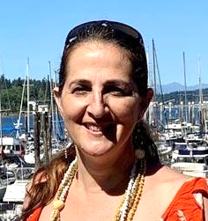
Luisa Castro, PhD, Assistant Director for FS&CS
Moved into the AD role in October 2022
Most recently served as the division’s Policy and Performance Administrator
20+ years of project management in higher education and cooperative extension, with water being an integral focus of much of her work
Assistant Water Quality Coordinator for Region IX (SW US and Pacific Islands), May 2003-June 2013
Water issues, both quality and quantity, will continue be an important focus in her new role
Notes:
For those of you who know Luisa Castro, in October she was promoted to Assistant Director for the Food Safety & Consumer Services Division.
She most recently served as the division’s Policy and Performance Administrator, where she provided operational leadership in setting goals and objectives and assisting programs in developing their strategic plans and performance measures. Luisa brings a broad scope of experience in management, with specific knowledge and practice in leading special projects. In addition to her policy and performance position, Luisa has been the interim Produce Safety Program Manager, interim RRT Coordinator, interim Food Safety Program Manager, and Interim Assistant Director for the Food Safety & Consumer Services Division.
In addition to Luisa’s work experience at WSDA, she has more than 20 years of project management in higher education and in cooperative extension, with water being an integral focus of much of her work.
Luisa was the Assistant Water Quality Coordinator, for Region IX, from May 2003 to June 2013 and helped administer a $2.3M, ten-year USDA-NIFA water quality program where she coordinated activities integrating water quality research, education, and Extension efforts common to the twelve partners (Arizona, California, Hawaii, Nevada, America Samoa, Commonwealth of the Northern Mariana Islands, Federated States of Micronesia, Guam, Republic of the Marshall Islands, Republic of Palau, Dine College, and D-Q University).
Water issues, both quality and quantity, will continue be an important focus in her new role.

Slide 5
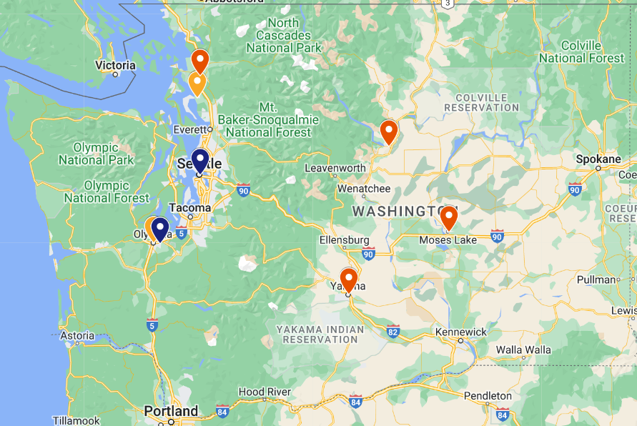
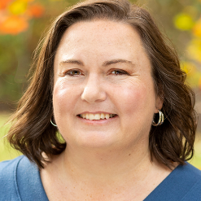
The WSDA Produce Safety Team
Travis Alexander
Inspector
Jerrid Higgins
Inspection Supervisor
Leah Grewal
Inspection Admin Coordinator
Karen Ullman
Assistant Prog Mgr, Ed & Out Coordinator
Thane Tupper
Inspector
Bradley Guise
Administrative Assistant
Evan Low
Inspector
Connie Fisk
Program Manager
Notes:
Here are my team members and their locations around the state. (highlight unique education and experience they bring to the team)
I’m the Program Manager and am based in Olympia. I hold a PhD in Horticulture and a Master’s degree in Food Science & Technology and Horticulture. Before joining WSDA in 2021, I worked for the Produce Safety Alliance, creators of the one-day training all farms covered by the FSMA Produce Safety Rule need to send one supervisor or responsible party through.
Bradley Guise is our newest hire. He joined us as Administrative Assistant last month and is based on Olympia.
Karen Ullmann is our Assistant Program Manager and Education & Outreach Coordinator, based in Seattle. She’s been with the agency in various roles since 2014 and just recently moved to Produce Safety full time. She holds a Bachelor’s degree in Intercultural Studies and will complete her MBA from the University of Washington in June of 2023. In addition to serving as our Education & Outreach Coordinator, Karen is also the primary point-of-contact for our farm inventory.
Leah Grewal is our Inspection Administrative Coordinator based in Stanwood, WA. Her main job duty is to contact produce growers to verify farm information and to schedule inspections. She came to us with seven years of administrative experience with the Washington State Patrol and holds a Master’s Certificate in Enterprise Risk Management, so she’s also our primary point-of-contact for Produce-related Emergency Assignments.
Travis Alexander is one of three inspectors we hired in 2022 and is based in Mount Vernon, WA. He holds a PhD in Horticulture.
Jerrid Higgins is our Inspection Supervisor based in Chelan, WA. He joined the program in 2018 as an inspector and moved into the supervisor role in March of this year. He holds a Bachelor’s degree in Agriculture and Food Systems and a Master’s in Sociology.
Thane Tupper is another inspector hired in 2022. He’s based in Moses Lake and came to us from the Commodity Inspection Division. He holds a Master’s degree in Environmental Policy and Management and is a great resource on cleaning and sanitizing from his time in the brewing industry as well as being a great resource on wildlife management. He owns a falconry business that farms can hire to take care of pests in agricultural fields.
And Evan Low is our newest inspector. He currently lives in Lacey, but in the spring will be moving to Southeast Washington. He holds a Bachelor’s degree in Agroecology.
So as far as Produce Safety Updates, we’ve had a lot of turnover in the last couple years, but have successfully refilled all our positions and are excited for all we’ll be able to accomplish in 2023!

Slide 6
WSDA Produce Safety Program Goals
Goal 1:
Conduct ongoing program assessments and planning that are essential to sustainable implementation of the PSP.
Maintain foundational resources necessary to implement a sustainable PSP.
Goal 2:
Routinely provide education, outreach, and technical assistance opportunities to the Washington produce industry.
Goal 3:
Conduct ongoing quality control of farm inventory in order to maintain a complete and accurate database of Washington produce farms.
Goal 4:
Ensure PSP’s inspection regulatory program focuses on quality and national consistency.
Goal 5:
Coordinate implementation of a quality compliance and enforcement program for the regulated produce industry.
Goal 6:
Strengthen PSP’s event response planning infrastructure to build upon existing systems for detecting, investigating, mitigating, and analyzing produce-related outbreaks.
Goal 7:
Notes:
For those of you who may be unfamiliar with what our program does, I’m going to provide a high-level overview and then get into the FSMA Proposed Rule on Agricultural Water that was released for comment last December (https://www.fda.gov/food/food-safety-modernization-act-fsma/fsma-proposed-rule-agricultural-water).
The WSDA Produce Safety Program is 100% funded by the FDA on a 5-year cycle. Here are our goals for July 2021 to June 2026. I’ve indicated our main activities there in orange text, and for the sake of time (click), I’m just going to focus on goals 3 through 5 today.

Slide 7
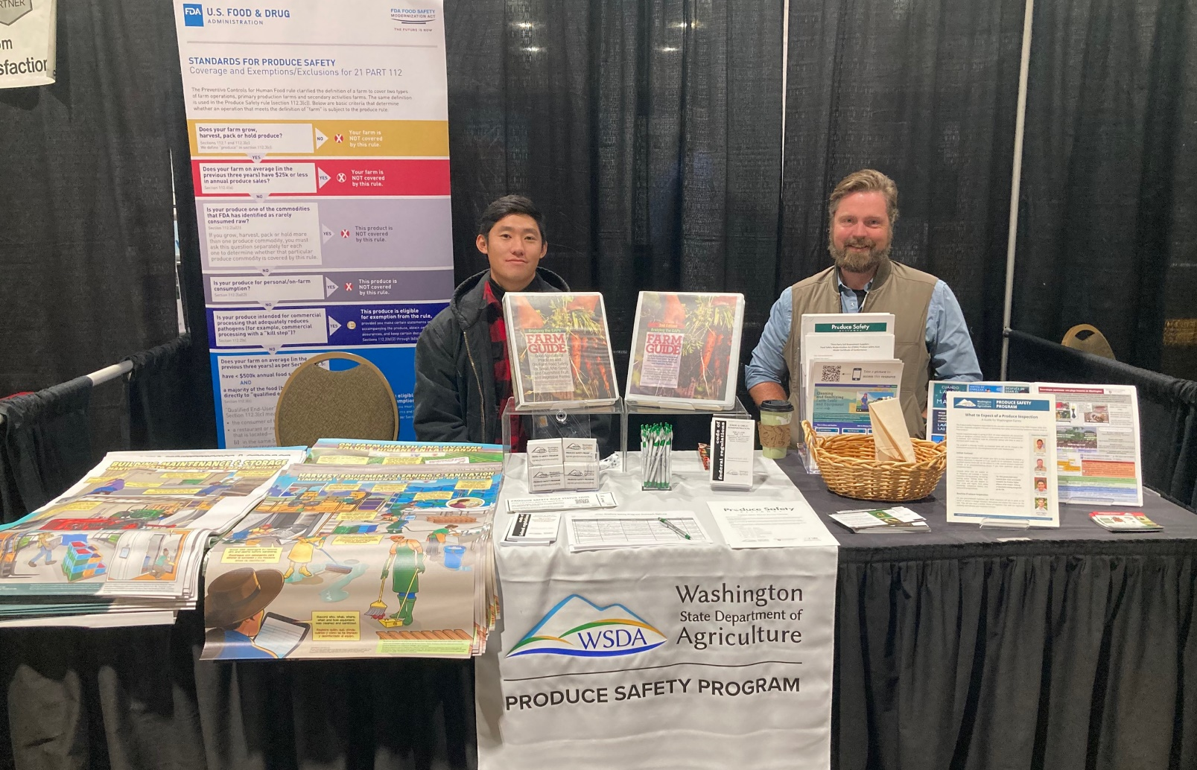
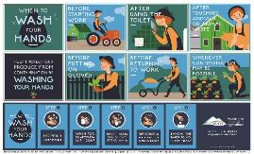
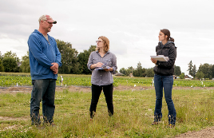
Education, Outreach, and Technical Assistance
PSA Grower Trainings reaching ~2,750 residents
Presentations to growers and industry groups and at state, regional, and national conferences
Numerous posters, podcasts, and fact sheets
On-Farm Readiness Reviews
Notes:
One of our primary mandates from FDA is to educate growers about the requirements of the Food Safety Modernization Act Produce Safety Rule.
We do this by providing… (read slide - remember to explain what an OFRR is)
--
Photos on right: (top) Evan and Thane at the PNW Vegetable Association Annual Meeting, November 2022; (bottom) Karen and Kelly at OFRR demo Mt Vernon research station, September 24, 2018 (Meryl Schenker, photographer)

Slide 8
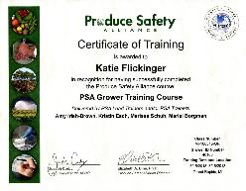
Register for a 2023 PSA Grower Training
January 27 – Spokane (English)
March 14 – Port Hadlock (English)
March 16 – Mt. Vernon (English)
March 30 – Wenatchee (Spanish)
March 31 – Wenatchee (English)
April 14 – Vancouver (English)
PSA TTT January 31-February 2 – Vancouver, WA
John Doe
Connie Landis Fisk, Karen Ullman
WA-180315-GR
40865
Port Hadlock, WA
https://agr.wa.gov/producesafety → TRAININGS
Notes:
Here are the dates for our 2023 PSA Grower Trainings in Washington. Visit our website and click on “trainings” for more information and registration links when they’re available. Registration for Washington residents is just $25 and that includes the manual and course completion certificate.
Remember, every farm covered by the FSMA Produce Safety Rule must send at least one supervisor or responsible party through this course.
We’re also co-hosting a PSA TTT with WRCEFS in Vancouver, WA January 31-February 2, 2023. Registration will be available soon, but if you know someone who would like to become a PSA Trainer, they can email me for details.

Slide 9
Posters Available for Download and Ordering
Notes:
We have several educational resources that came out this year. The first is this set of six berry posters, with text in English and Spanish. (read poster titles)
The posters can be downloaded and printed in large format (up to 24" wide x 36“ tall) or ordered on our program website (https://agr.wa.gov/producesafety - see the Resources page for details).

Slide 10
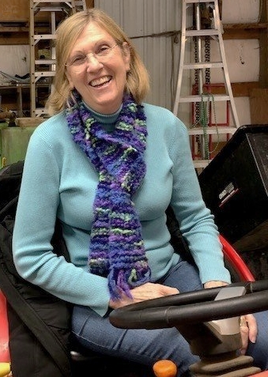
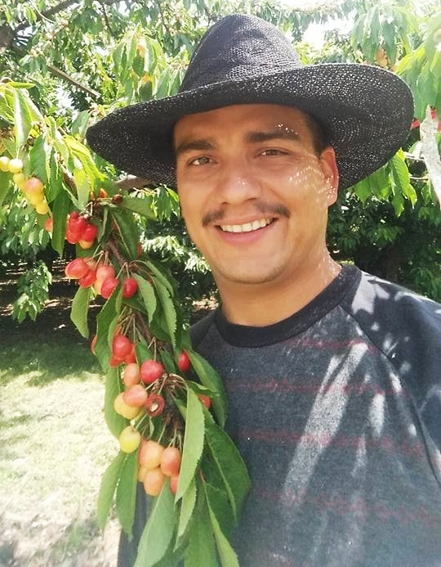
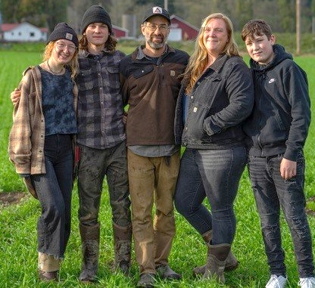
Farm Walks Podcast
www.farmwalks.org
Val Wall of Whitehorse Meadows Farm
Haley and Zach of Dharma Ridge Farm
Osman Amador of Amador Farms
Notes:
This past year we also recorded three episodes of the Farm Walks Podcast with the WSU Food Systems Program and Tilth Alliance. Each includes interviews of a grower and a resource provider on a produce safety topic (Karen and I from WSDA and Jacqui Gordon Núñez from the Washington State Tree Fruit Association). These episodes have each been downloaded 4-500 times (when we checked in September)!
Source of photos: Farm Walks website (see link on slide)

Slide 11
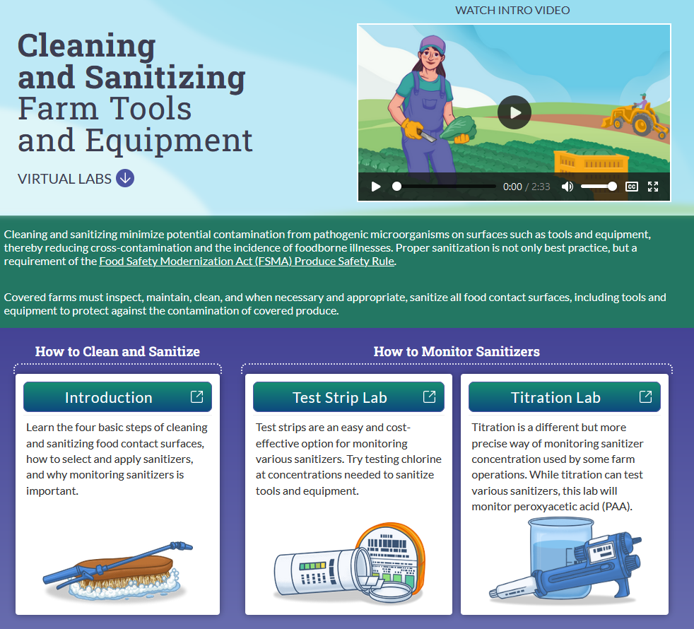
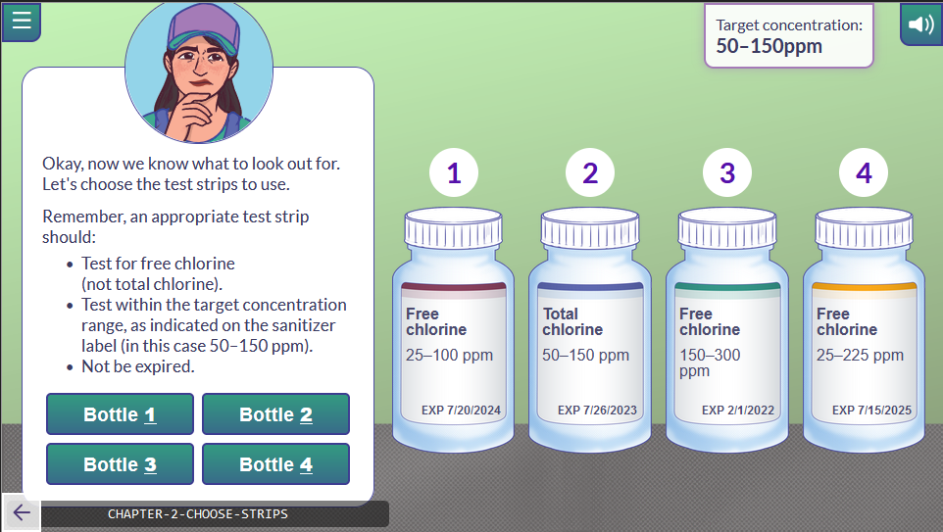
Interactive Cleaning and Sanitizing Online Learning Modules
farmsanitizing.nmsu.edu
Notes:
And the third educational resource we’ve created this past year is this animated tool with interactive online learning modules, in collaboration with Faith Critzer, now at University of Georgia, with design production by New Mexico State University’s The Innovative Media Research and Extension Program.
The first module is an introduction to cleaning and sanitizing to set the stage for the two in-depth labs designed to teach farm workers how to monitor sanitizer concentration, either with test strips or titration.
The tool is available in English and Spanish via the website URL farmsanitizing.nmsu.edu. You can also reach the site by pointing your cell phone camera at the QR code on the screen.

Slide 12
Produce Farm Inventory
Large Covered Farms (>$500K) | 436
Small Covered Farms (>$250K-500K) | 144
Very Small Covered Farms (>$25K-250K) | 252
Current Total Covered Farms | 832
Farms w/ Produce Sales ≤$25K | 224
ONLY Rarely Consumed Raw | 53
ONLY Commercial Processing Exempt | 101
Qualified Exempt Farms | 131
Source of photo: WSDA on flickr, https://www.flickr.com/photos/wsdagov/
Notes:
Our next primary mandate from FDA is development of a produce farm inventory. Again, this includes farms covered by the FSMA Produce Safety Rule. So far, we’ve verified 832 produce farms covered by the Rule. We plan to put significant effort into improving this number this winter as we need to be able to contact all these farms with the new PSR water requirements when they’re finalized.
The PSR excludes farms that sell less that $25,000 in produce a year, those that only grow crops FDA deems rarely consumed raw like potatoes, those that go through commercial processing considered a “kill step” like juice pasteurization or canning, and farms considered qualified exempt meaning that they sell less than $500,000 in annual food sales with more than half being sold directly to the consumer or local restaurants or retail establishments (that one’s a little complicated, so please let me know if you have any questions).
--
Photo of blueberries: WSDA on flickr (CC BY-NC 2.0), https://flic.kr/p/MjwJKQ

Slide 13
Produce Farm Inspections by Year
20% of 832 verified farms = 166 inspections/year
74 in FY20
11 in FY21
58 in FY22
134 in FY23, so far
Number of Cumulative Inspections in by Fiscal Year
Source of photo: WSDA on flickr, https://www.flickr.com/photos/wsdagov/
Notes:
And the third priority area from FDA that I want to highlight today is our farm inspections (the “farm” definition includes packinghouses). That’s how we verify that Washington farms are complying with the Produce Safety Rule requirements.
The majority of our inspections are conducted during the months of June to October. This year we were still focused on our initial inspections of large farms, moving into small farms. We’ve also made an effort to inspect farms growing priority crops, which for Washington means onions.
This chart shows cumulative number of inspections by fiscal year (that’s July 1st to June 30th) and farm size. You can see that our numbers made a big jump in FY20 (the gold bars), but then COVID hit and we evened off with just a slight rise for FY21. We were only able to conduct 58 inspections in FY22 due to lingering effects of COVID restrictions and high inspection staff turnover. This fiscal year we have already conducted 134 inspections.
With our inspection team now fully staffed, we should be able to inspect at least 20% of our verified farm inventory, 166 farms based on our current 832 verified covered farms, each year. Knowing that priority crops are to be inspected every 3 years, the target number of inspections will be about 185 next year.
--
Photo of apples: WSDA on flickr (CC BY-NC 2.0), https://flic.kr/p/2htt53x

Slide 14
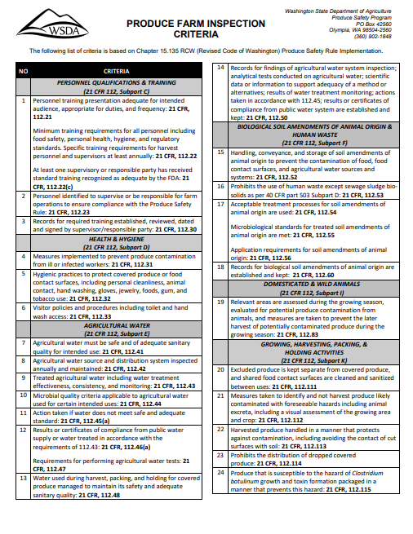
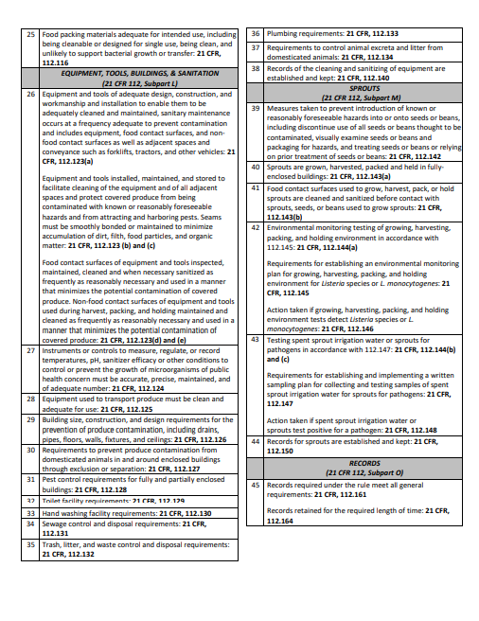
Inspection Process
Schedule inspection
Collect basic farm details, answer questions, email resources
Conduct on-site inspection
Observe harvest, packing, holding, and other pertinent facilities
Discuss observations and corrections with grower
Educate before and while we regulate
Notes:
This is the inspection criteria form. It’s available on our website so growers know exactly what our inspectors will be looking at during the inspection.

Slide 15
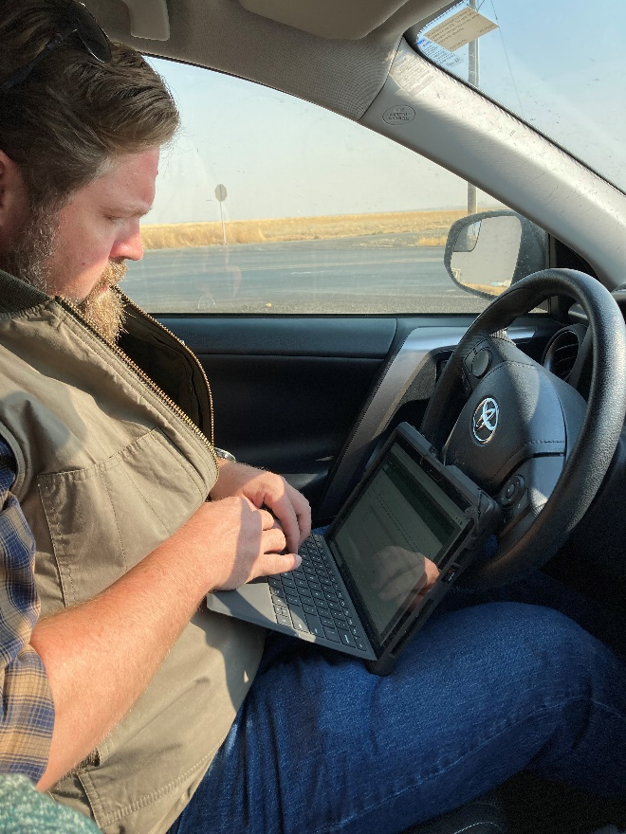
Inspection Observations
Seen so far:
Not yet attending a PSA Grower Training
Missing records; records missing required details
Worker training missing required topics
Insufficient cleaning and sanitizing of equipment
For the most part, WA farms are doing the right thing!
Notes:
Some of the Produce Safety Rule misses that we’ve seen so far include… (read slide)
But for the most part, Washington farms are doing the right thing!
(Large farms are already participating in third party audits, so small and very small farms are benefitting the most from our education, outreach, technical assistance, and initial (educational) inspection efforts.)

Slide 16
Notes:
Now, with my remaining time I want to cover where we’re currently at with Produce Safety Rule water requirements. This includes the FSMA Proposed Rule on Agricultural Water as well as FDA’s Proposed Compliance Date Extension for the Pre-Harvest Agricultural Water Requirements.
These slides are provided by the Produce Safety Alliance (https://resources.producesafetyalliance.cornell.edu/documents/Subpart-E-supplemental-ppt-slides.pptx).

Slide 17
Notes:
On December 7, 2021, FDA published a Proposed Rule called Standards for the Growing, Harvesting, Packing, and Holding of Produce for Human Consumption Relating to Agricultural Water.
The proposed requirements in the Rule shift from testing as the primary metric for decision-making to an Agricultural Water Assessment (AgWA) intended to look at the whole production system including agricultural water, crop characteristics, and adjacent land.
The expectation for each grower is to set their standards and understand why those standards are appropriate for their farm. Additionally, growers should be prepared to explain those decisions to inspectors.

Slide 18
Notes:
The FDA’s Agricultural Water Proposed Rule, if finalized as currently written, would replace the pre-harvest microbial quality criteria and testing requirements as the primary way to assess the safety of the water that contacts covered produce in the FSMA Produce Safety Rule with the requirement for systems-based pre-harvest agricultural water assessments (AgWA) that covered farms would use for hazard identification and risk management decision-making purposes.
As part of the assessment, the farms would be required to evaluate the following factors to identify conditions that would be reasonably likely to introduce known or reasonably foreseeable hazards into or onto produce or food contact surfaces:
Agricultural water system(s)
Agricultural water practices
Crop characteristics
Environmental conditions
Other relevant factors

Slide 19
Notes:
The chart in this slide summarizes the proposed requirements and options for responses based on AgWA determinations. These corrective or mitigation measures would reduce the potential for contamination of produce or food contact surfaces with hazards associated with pre-harvest agricultural water.
The color-coding in this slide emphasizes the time frame for responses, based on risk. Orange indicates an urgent need (highest priority), blue indicates medium priority, and green indicates lowest priority. (read through each row)
--
The following responses to questions received during development of this supplemental slide set may be useful during delivery:
What does it mean for water to be safe or of adequate sanitary quality? FDA provided one description in the Preamble to the 2015 FSMA Produce Safety Rule. Water containing dead and decaying animals (deer) is not safe or of adequate sanitary quality for use as agricultural water because “the water is reasonably likely to contain human pathogens transferred by the dead and decaying deer” (Response to Comment 246).
Can the AgWA be avoided by performing an annual inspection and use of the microbial water quality profile (MWQP) like in the 2015 version? According to FDA documentation accompanying the proposed Subpart E revision, any pre-harvest water tests are intended to support the findings from the AgWA, not replace the AgWA:
“Proposed §112.43(d) would establish the requirements applicable to testing that a covered farm chooses to conduct to provide additional information for its agricultural water assessment” (page 74 of the proposed Subpart E requirements).
Note that nowhere in the proposed revision is testing identified as a basis for exemption from AgWA requirements (see proposed §112.43(b)).
--
However, the slide on Exemptions states that “Covered farms would be exempt from conducting a pre-harvest agricultural water assessment if they can demonstrate that their pre-harvest agricultural water for covered produce: 1) Meets certain requirements that apply for harvest and postharvest agricultural water (such as the microbial quality criterion and testing requirements for untreated ground water); 2) Is received from a public water system or supply that meets requirements established in the rule (provided that the farm has public water system results or certificates of compliance demonstrating that the water meets relevant requirements); or 3) Is treated in accordance with the standards outlined in the Produce Safety Rule.”

Slide 20
Notes:
Note: This slide is meant to highlight the differences between corrective measures and mitigation measures. The definitions of corrective measures currently in Module 5.1 are, in some cases, different than the corrective measures in the proposed revisions to Subpart E. There is also a new term introduced in the proposed revisions to Subpart E, mitigation measures. (The color-coding in this slide aligns with the colors established in the previous slide.)
Based on the outcomes of the agricultural water assessment, the following corrective measures or mitigation measures must be put into place.
Corrective measures: If a covered farm determines that its pre-harvest agricultural water is not safe or of adequate sanitary quality for its intended use(s), it would be required to immediately discontinue such use. Corrective measures a farm could take in order to resume use include:
Re-inspecting the entire affected agricultural water system under the farm’s control and, among other steps, making necessary changes; or
Treating the water in accordance with the standards outlined in the Produce Safety Rule
Mitigation measures: If a covered farm determines that mitigation measures are necessary to reduce the potential for contamination of produce or food contact surfaces with hazards associated with their pre-harvest agricultural water, there are various options to choose from, including:
Making necessary changes such as repairs;
Increasing the time interval between the last direct application of agricultural water and harvest of the covered produce to a minimum of 4 days (except when otherwise supported by test results or other scientifically valid information) to allow for microbial die-off;
Increasing the time interval between harvest and the end of the storage period, to allow time for microbial die-off to occur.
Changing the method of water application to reduce the likelihood of produce contamination (such as changing from overhead spray to drip irrigation for certain crops);
Treating the water in accordance with the standards outlined in the Produce Safety Rule; or
Taking alternative mitigation measures supported by scientific data and information.

Slide 21
Notes:
Reassessment: A covered farm would be required to conduct a reassessment each year in which the farm applies pre-harvest agricultural water to covered produce (other than sprouts), and anytime there is a significant change in its agricultural water systems, agricultural water practices, crop characteristics, environmental conditions, or other relevant factors that make it reasonably likely that a hazard will be introduced into or onto produce or food contact surfaces through direct application of pre-harvest agricultural water. For example, a change from an untreated ground water source to an untreated surface water source would be a significant change that would require a reassessment.
The reassessment would evaluate the impacts of those changes on the factors discussed above, any new hazards identified, and the written determination of whether corrective or mitigation measures are needed to reduce the potential for contamination of produce or food contact surfaces.

Slide 22
Notes:
Exemptions: Covered farms would be exempt from conducting a pre-harvest agricultural water assessment if they can demonstrate that their pre-harvest agricultural water for covered produce (other than sprouts):
Meets certain requirements that apply for harvest and postharvest agricultural water (such as the microbial quality criterion and testing requirements for untreated ground water);
Is received from a public water system or supply that meets requirements established in the rule (provided that the farm has public water system results or certificates of compliance demonstrating that the water meets relevant requirements); or
Is treated in accordance with the standards outlined in the Produce Safety Rule.
Note: A farm needs to support these exemptions with records.
--
Proposed Rule language that may be helpful to better understand expectations associated with exemptions (front material to the proposed rule, page 68): "Under proposed 112.43(b)(1), a covered farm would be exempt from the requirement to conduct an assessment for pre-harvest agricultural water if the farm can demonstrate that the agricultural water meets the requirements of proposed 112.44(a), which is applicable to agricultural water use for sprout irrigation or for harvest or postharvest uses -- i.e. untreated ground water that meets the microbial water criterion of no detectable generic E. coli, based on testing requirements in proposed §§ 112.44(b), 112.47, and 112.151."
Based on PSA understanding, the farm must be able to demonstrate that the water meets the postharvest criteria through test results from on-farm water testing or public water system testing.

Slide 23
Notes:
Records: Covered farms would be required to maintain written records of their pre-harvest agricultural water assessments, including descriptions of factors evaluated and their written determinations.
Farms that test their pre-harvest agricultural water as part of their assessments would be required to maintain certain documentation related to their sampling and testing procedures.
Additionally, supervisors would be required to review and sign the written pre-harvest agricultural water assessments and the determinations made based on the outcomes of the assessments.
--
The following Proposed Rule language may be valuable in understanding the recordkeeping requirements:
§ 112.50: Under this subpart, what requirements apply regarding records? (a) You must establish and keep records required under this subpart in accordance with the requirements of subpart O of this part…. (b) You must establish and keep the following records, as applicable: (1) The findings of inspections of your agricultural water systems in accordance with the requirements of § 112.42(a); (2) Your written agricultural water assessments, including descriptions of factors evaluated and written determinations, in accordance with § 112.43;…(5) Documentation of the results of all analytical tests for purposes of compliance with this subpart, including any testing conducted under §§ 112.43 and 112.44;…
§ 112.161: What general requirements apply to records required under this part?...(b) Records required under §§ 112.7(b), 112.30(b), 112.50(b)(2), (5), (7), and (10), 112.60(b)(2), 112.140(b)(1) and (2), and 112.150(b)(1), (4), and (6) must be reviewed, dated, and signed, within a reasonable time after the records are made, by a supervisor or responsible party.

Slide 24
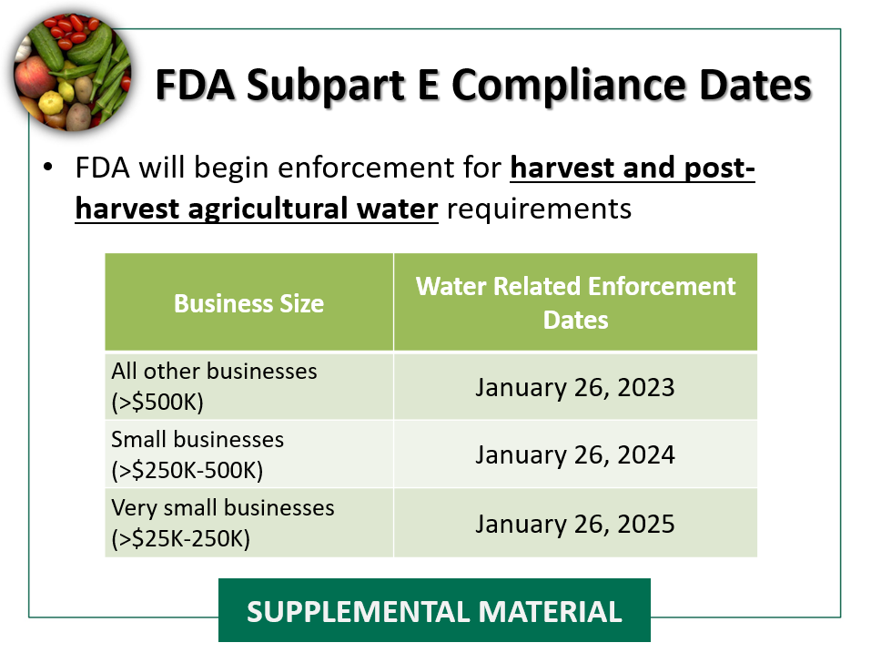
Notes:
The 2021 agricultural water proposed rule did not propose substantive changes to the harvest and postharvest agricultural water requirements in the Produce Safety Rule; however, the FDA recognizes that prior to the proposal, stakeholders did not have clarity on whether FDA might propose to change the harvest and postharvest agricultural water requirements.
In addition, the FDA recognizes that adequate training and technical assistance are needed to fully recognize the benefits of the harvest and postharvest requirements. Therefore, FDA intends to continue enforcement discretion for the harvest and postharvest agricultural water requirements of the Produce Safety regulation until the following dates:
January 26, 2023, for all other businesses
January 26, 2024, for small businesses; and
January 26, 2025, for very small businesses.

Slide 25
Notes:
The 2021 agricultural water proposed rule, if finalized, will require farms to conduct annual systems-based agricultural water assessments to determine and guide appropriate measures to minimize potential risks associated with pre-harvest agricultural water. The FDA is now proposing extended compliance dates for those proposed pre-harvest requirements and is also providing clarifying information about the enforcement discretion policy for the harvest and postharvest agricultural water requirements.
The supplemental rulemaking proposes to establish the following compliance dates for the pre-harvest agricultural water requirements for covered produce other than sprouts:
9 months after the effective date of a final rule for all other businesses.
1 year and 9 months after the effective date of a final rule for small businesses; and
2 years and 9 months after the effective date of a final rule for very small businesses.

Slide 26
Notes:
Here are some reminders for growers of steps they can take to prepare for the final agricultural water requirements.
Growers are still encouraged to test their water and follow Good Agricultural Practices (GAPs) to understand, protect and maintain the quality of their water.
(The fourth bullet is highlighted in orange to signify the importance of the recommendation to develop water management strategies, such as water system surveys, to identify and reduce risks.)
--
From current teaching notes to this slide in the PSA Grower Training curriculum (slide 28):
Growers should be encouraged to continue water testing if it is already being done to understand their water quality and maintain market access by meeting buyer and audit requirements.
Growers who are not testing but are interested in better understanding the quality of their water may want to begin testing for quantified generic E. coli. For surface water sources, a good recommendation for growers that are just beginning is to test three times per season (once before they start using the water and other tests during periods when they are using the water source). The goal is to begin the process of understanding water quality and how it might change over time.
Growers should follow Good Agricultural Practices to protect and maintain water quality. Growers may want to inspect their water source and distribution systems to assess risks that could impact water quality, for example, by surveying the land around the water source. This could include assessing activities happening upstream that may impact quality (e.g., operations that allow animal access to the water source such as grazing cattle).

Slide 27
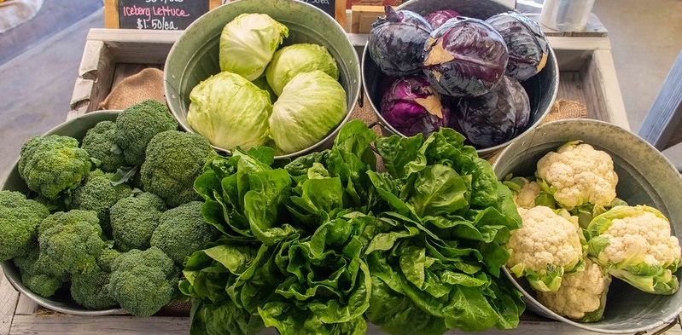
Questions?
Produce Safety Program Manager: Connie Fisk
Phone: (360) 545-2519
Email: CFisk@agr.wa.gov
Twitter: @connie_fisk
https://agr.wa.gov/producesafety
Images used in this presentation may not be reused without explicit written permission from the WSDA Communications Office
Notes:
Photo source: WSDA on flickr (https://flic.kr/p/2mxNi8R)

