Slide 1
WaterSMART Program
Sheri Looper & Katherine Tucker
Water Resources and Planning Office
November 30, 2022

Slide 2
Agenda Overview
WaterSMART Programs Overview
Funding Opportunities
BIL Funding
Application Tips
Program Resources
Questions

Slide 3
WaterSMART Program Overview
Growing Populations
Restoration Needs
Drought
Increases water supply reliability through investments and attention to local water conflicts
Supports water conservation and water management improvements to help meet competing demands for water
Leverages Federal and non-Federal funding
Relies on collaboration with stakeholders to develop local solutions to water supply issues

Slide 4
WaterSMART Program
Provides a framework for Interior to support water supply reliability for multiple water users.

Slide 5
Build a Foundation Through WaterSMART
CWMP Phase I
Drought Contingency Plans
Water Marketing Strategy Grants
Water Conservation Field Services Program
Applied Science Tools
Drought Resiliency Projects
Reservoir Operations Pilots
Water Management Options Pilots
Environmental Water Resources Projects
Drought Resiliency Projects
Small-Scale Water Efficiency Projects
Water and Energy Efficiency Grants
On-the-Ground Projects
Science and Tools
Planning

Slide 6
WaterSMART Program Basics
Most WaterSMART activities are grant programs
Generally a 50% non-Federal cost share is required for grants under WaterSMART
Applicants include entities such as states, tribes, cities, water districts, irrigation districts, watershed groups, non-profits, and flood control districts within the 17 Western United States and Territories, AK, HI, and Puerto Rico
Funding is allocated through annual competitive processes

Slide 7
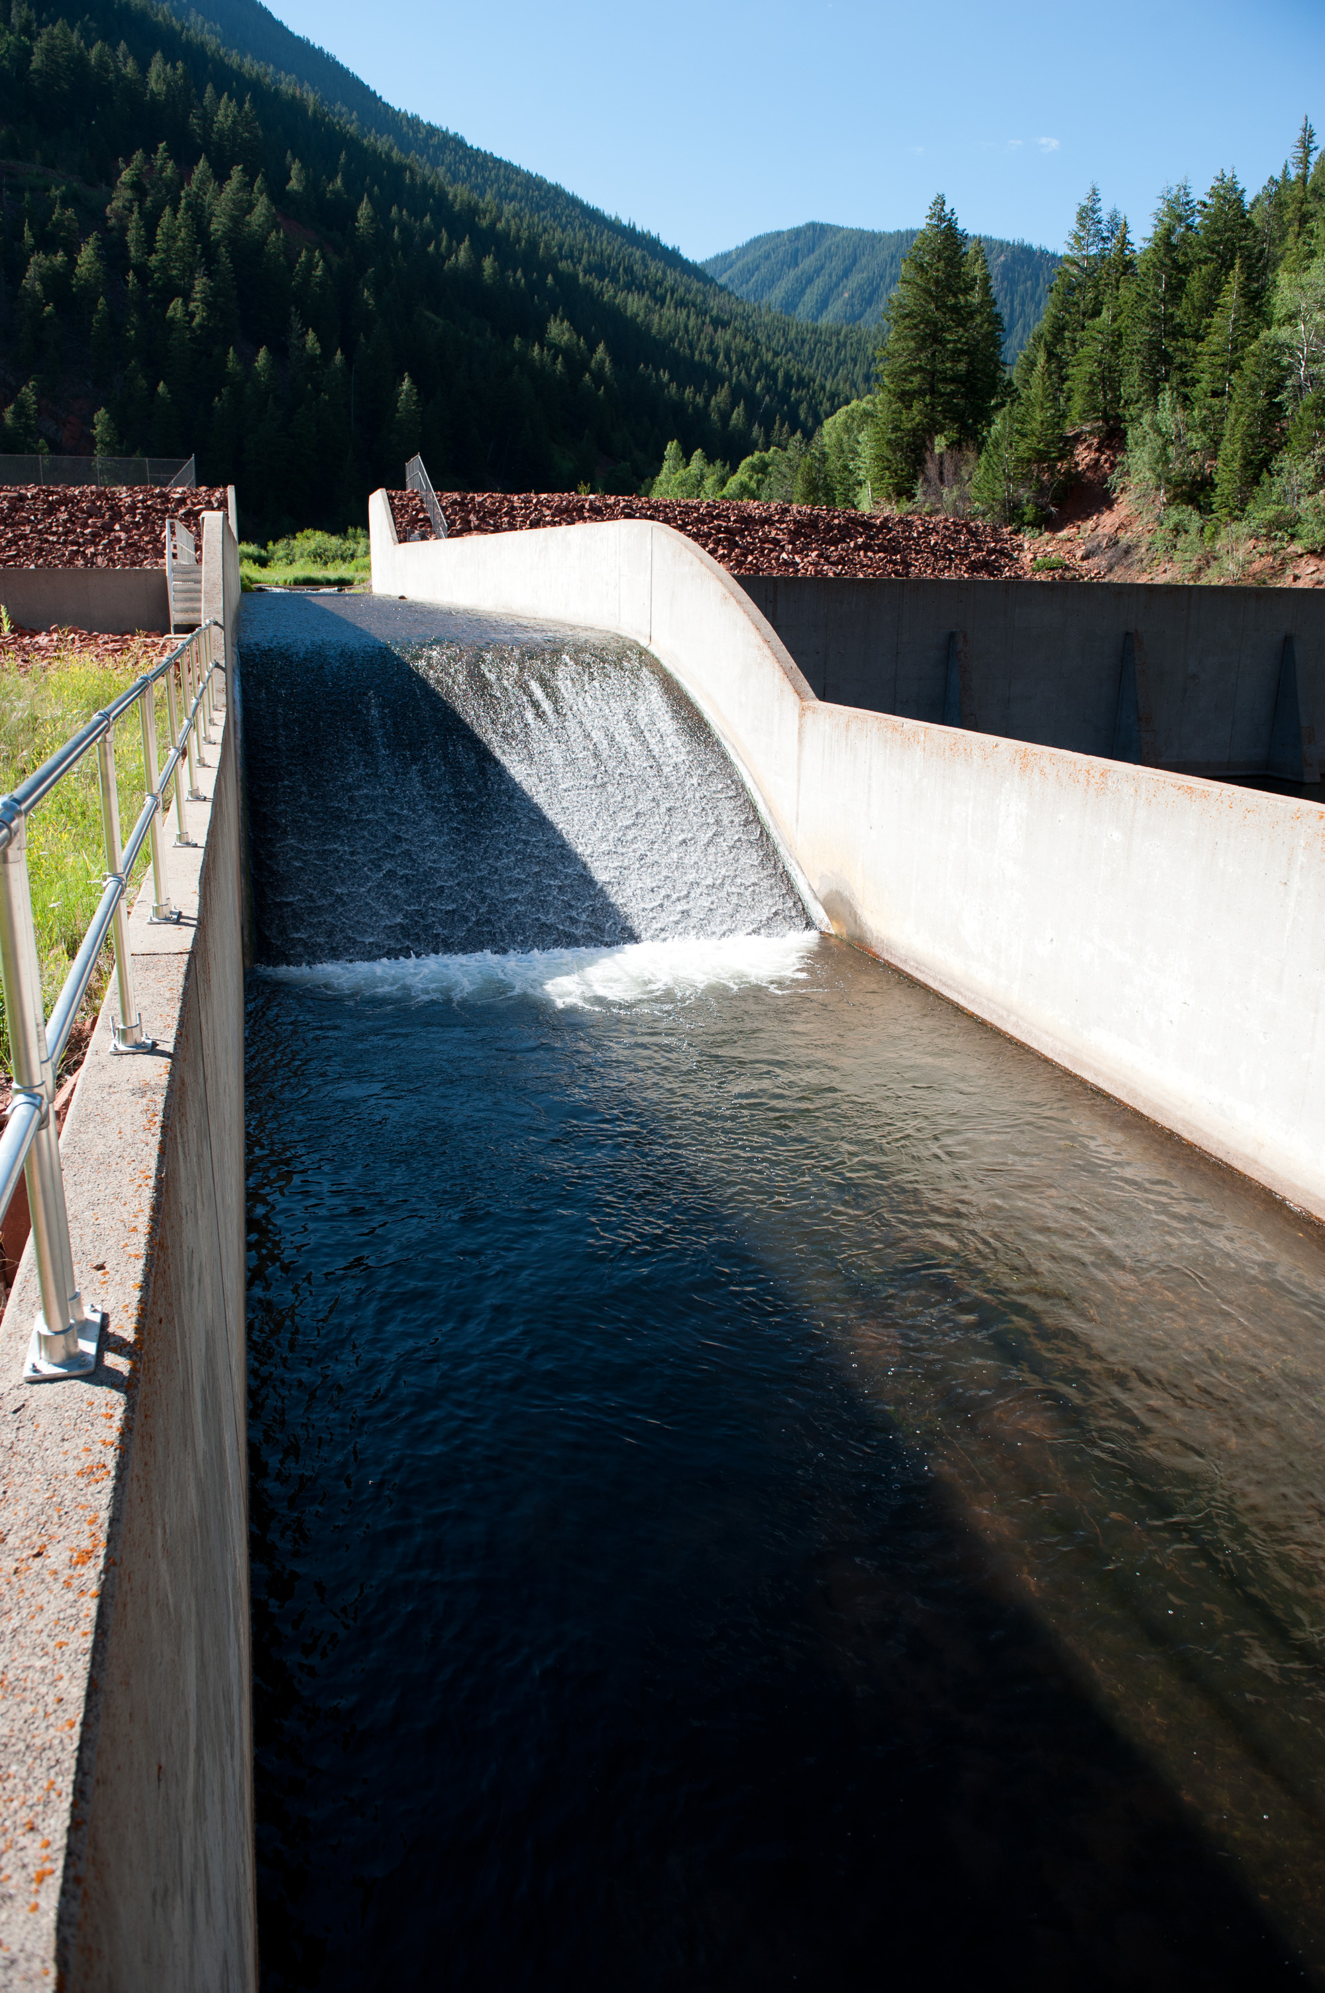
WaterSMART Grants Water and Energy Efficiency Grants
Eligible Project Types
Water Conservation Projects
Canal lining/piping
Municipal metering
Irrigation flow measurement
Supervisory Control and Data Acquisition and Automation (SCADA)
Landscape irrigation measures
High-Efficiency Indoor Appliances and Fixtures
Commercial Cooling Systems
Renewable Energy Projects
Hydropower
Solar, wind energy
Funding
Funding Group I: Up to $500k in 2 years
Funding Group II: Up to $2 million in 3 years
Funding Group III: Up to $5 million in 3 years
Non-Federal Cost Share: 50% or greater
Criteria focus on quantifying water savings
Funding Opportunity Anticipated Spring 2023

Slide 8
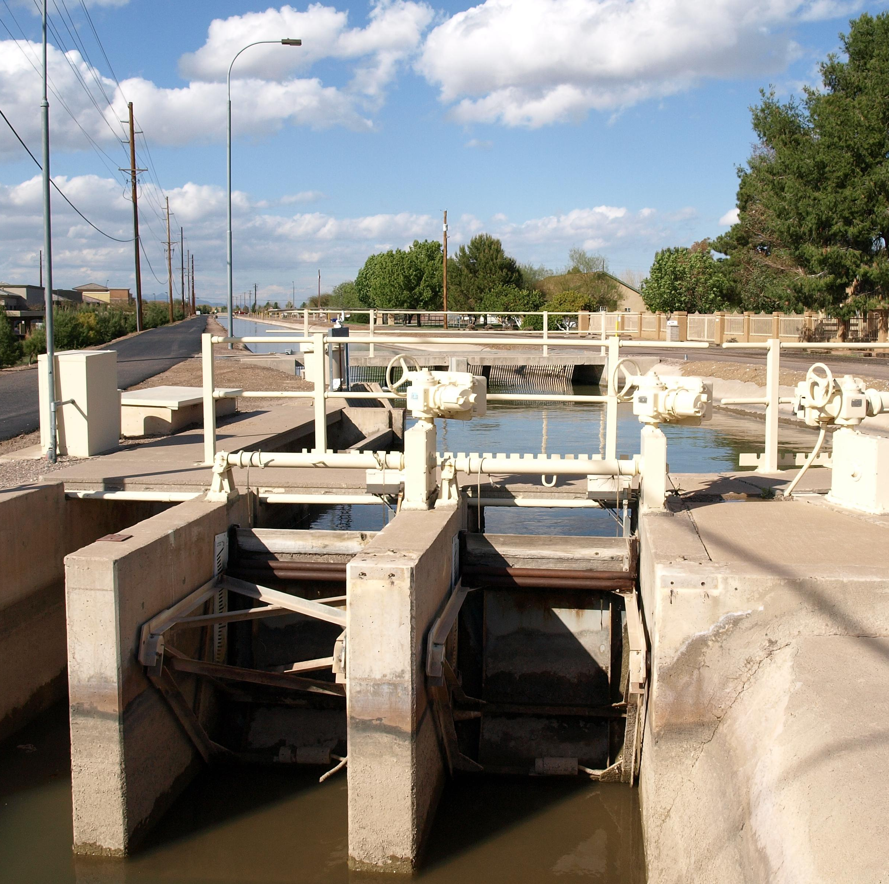
WaterSMART Grants Small-Scale Water Efficiency Projects
Eligible Project Types
Canal lining/piping
Municipal metering
Irrigation flow measurement
Supervisory Control and Data Acquisition and Automation (SCADA)
Landscape irrigation measures
High-Efficiency Indoor Appliances and Fixtures
Commercial Cooling Systems
Funding
Up to $100k in Reclamation funds
Maximum total project costs of $225k per project
Non-Federal Cost Share: 50% or greater
Evaluation Criteria
Simplified evaluation criteria
Benefits to applicant
Previous planning efforts supporting the project
Funding Opportunity Anticipated Spring 2023

Slide 9
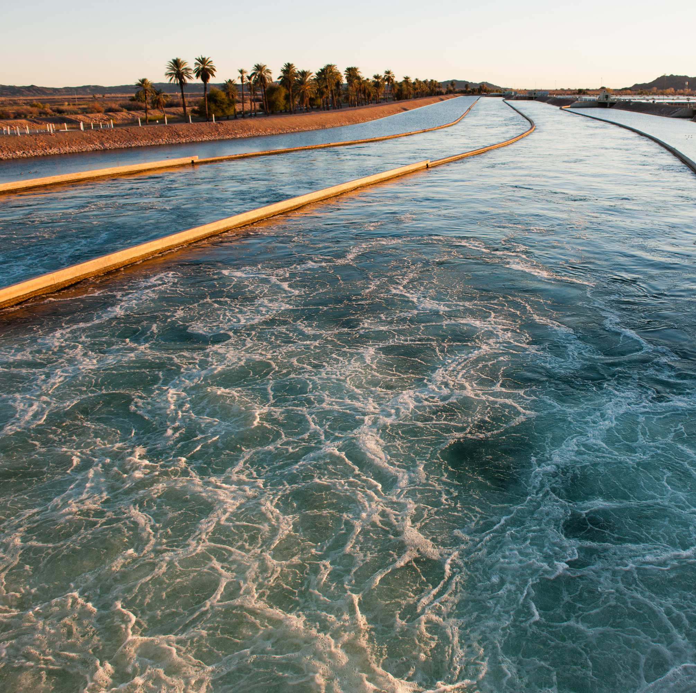
WaterSMART Grants Water Marketing Strategy Grants
Eligible activities:
Outreach and partnership building for water markets
Scoping and planning
Development of a water marketing strategy document
Pilot activities to further the development of a water marketing strategy
Funding levels:
Up to $200k for a 2-year project
Up to $400k for a 3-year project
Non-Federal Cost Share: 50% or greater
Funding Opportunity Anticipated Winter 2023
Notes:
Eligible applicants: States, tribes, irrigation and water districts and other entities with water delivery authority
Program Objective: Water markets between willing buyers and sellers can help meet demands efficiently in times of shortages, preventing conflicts

Slide 10
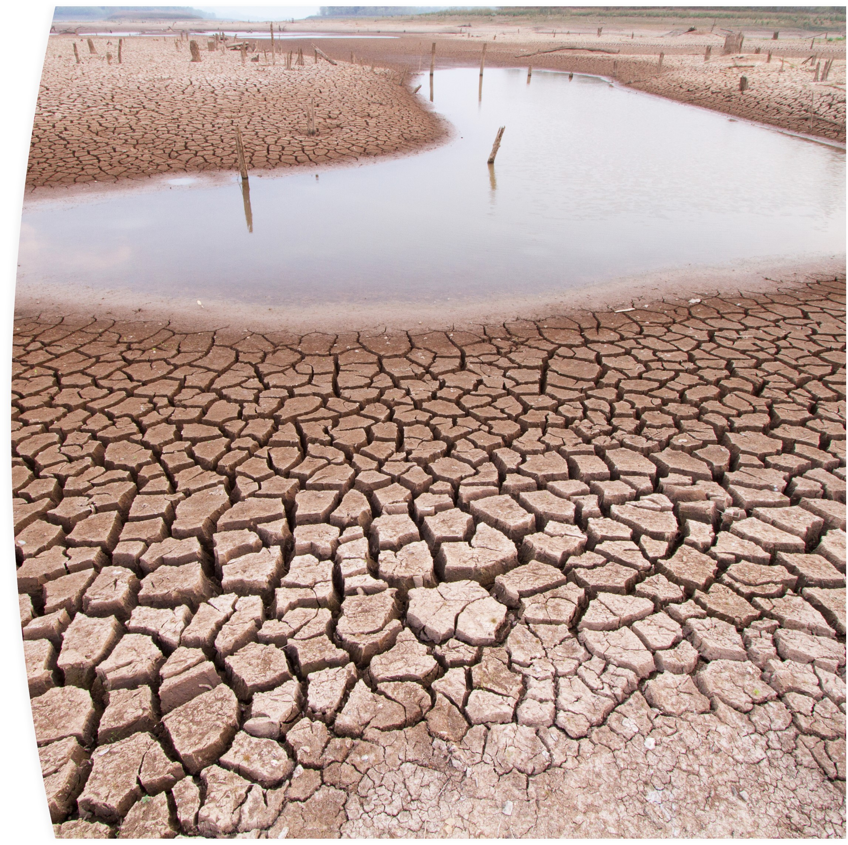
Drought Response Program Drought Resiliency Projects
Eligible Project Types
Infrastructure Improvements
New conveyance system components
Additional water storage
Recharge facilities
Capture and treat alternative supplies
Decision Support Tools & Modeling
Environmental Protection
Funding
Funding Level I: $500k, projects completed in 2 years
Funding Level II: $2 million, projects completed in 3 years
Funding Level III: $5 million, projects completed in 3 years
Non-Federal Cost Share: 50% or greater
Funding Opportunity Anticipated Spring 2023

Slide 11
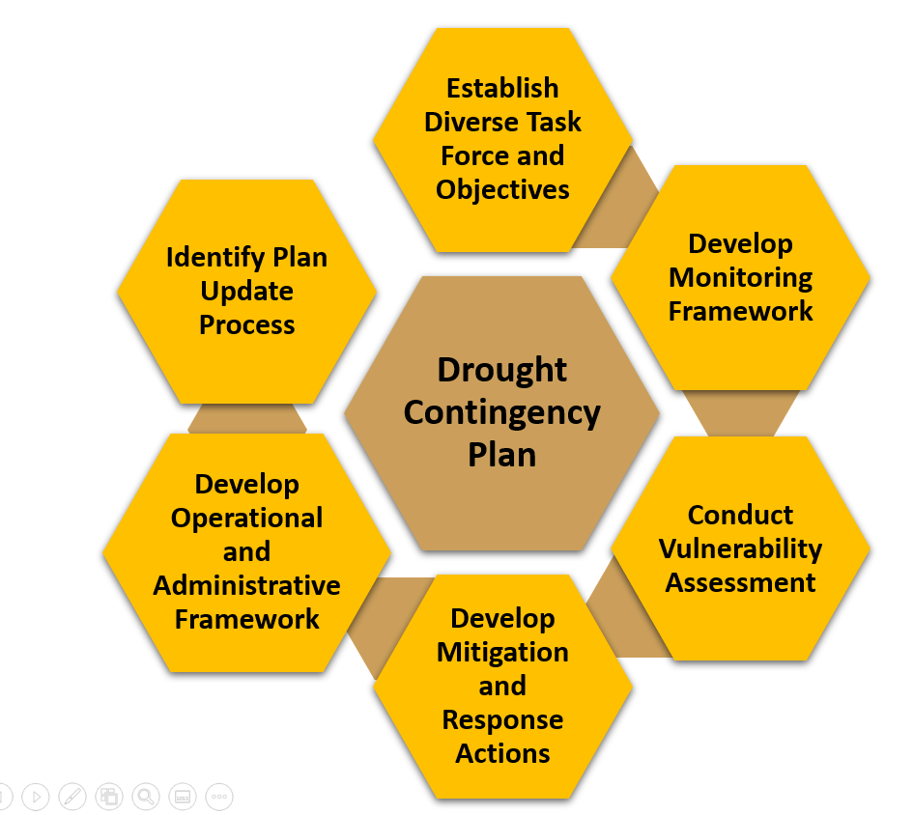
Drought Response Program Drought Contingency Planning
Eligible Projects
Development or update of comprehensive drought plans
Funding
Non-Federal Cost Share: 50% or greater
Cost share reduction/waiver available for applicants with financial hardship or a significant Federal interest
Up to $200,000
Eligible Applicants
Same as Category A for WEEG, SWEP, DRP
Funding Opportunity Anticipated Winter 2023

Slide 12
Applied Science Grants
Eligible Projects
Improve or enhance modeling capabilities
Improve or adapt forecasting tools and technologies
Improve access to and use of water resources data
Funding
Up to $200k for a 2-year project
50% non-Federal cost share required
Funding Opportunity Anticipated Winter 2023
Notes:
Eligible applicants: states, tribes, irrigation districts, water districts, universities, nonprofit research institutions, organizations with water or power delivery authority, or nonprofit organizations

Slide 13
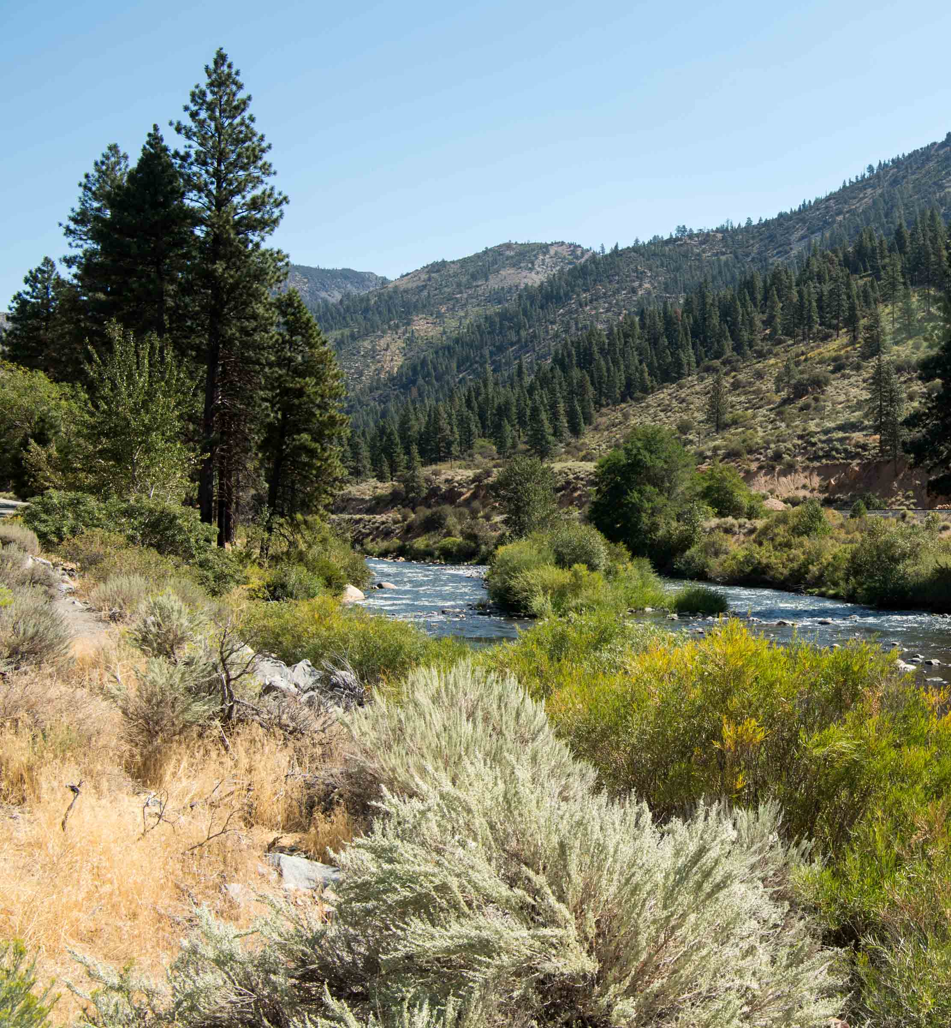
Cooperative Watershed Management Program Phase I – Watershed Group Development and Planning
Eligible Project Activities
Watershed group development
Conducting outreach activities
Gathering data about the watershed
Watershed restoration plans
Watershed management project design
Funding
Up to $200,000 in Reclamation funding over 2 years
Sufficiency review required for second year funding
0% non-Federal cost share required
Funding Opportunity Anticipated Spring 2023

Slide 14
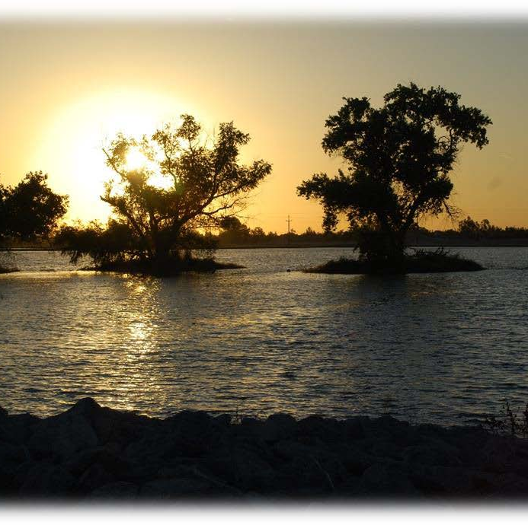
Environmental Water Resources Projects
Eligible Project Types
Water conservation and efficiency projects that increase reliability for ecological values or watershed health
Water management and Infrastructure Improvements to benefit ecological values and watershed health
Watershed management or restoration projects benefitting ecological values or watershed health
Projects to improve the condition of a natural feature or nature-based feature
Funding
Non-Federal Cost Share: 25% to 50%
Funding Level: Up to $3 million 3 years
*Section 40907 of the BIL (Multi-Benefit Projects to Improve Watershed Health) will be implemented through the EWRP starting in FY23*
Funding Opportunity Anticipated December 2022

Slide 15
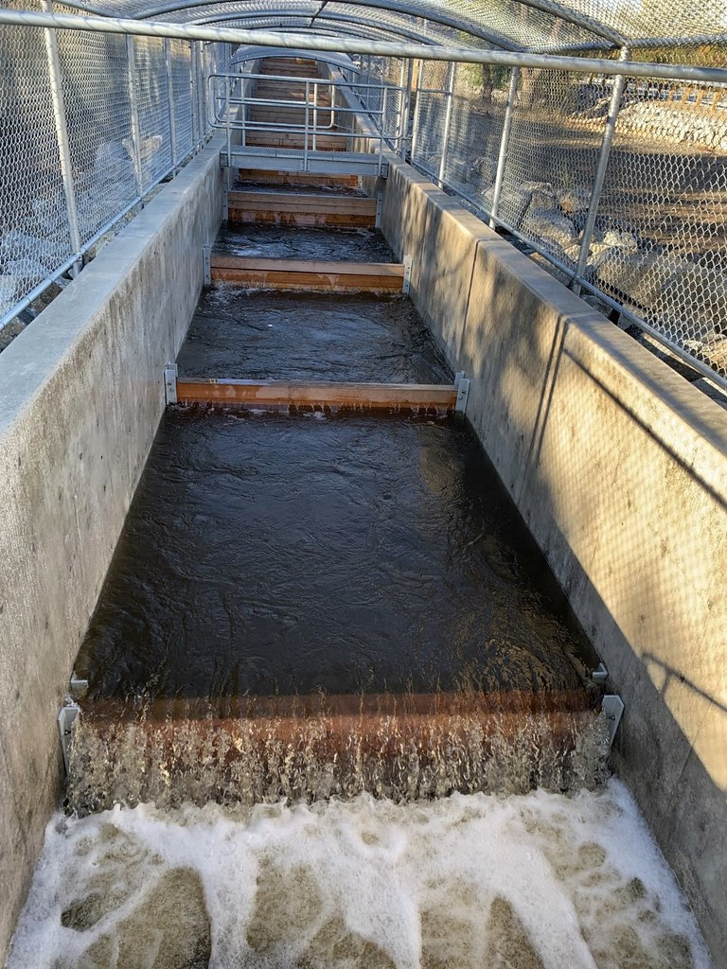
Aquatic Ecosystem Restoration Projects
Eligible Project Types
Funds the study, design, and construction of large-scale aquatic ecosystem restoration and protection projects
Projects should improve habitat or fish passage, including through the removal or bypass of fish barriers
Prioritizes projects that provide regional benefits (across multiple basins), are a component of an aging infrastructure strategy, or benefit an underserved community
Two Phases
Planning and Design
Construction
Funding Opportunity Expected Winter 2022/23. This is a new program currently under development.
Notes:
A Reclamation team is currently developing program criteria and example project types.
We expect to provide an opportunity for public comment on the criteria this fall, with a funding opportunity by the end of the year.
Removal or modification of a dam requires owner consent or no written objection form entities that collectively receive 1/3 or more of the water or power from the facility
Public comment will be considered prior to initiating a project

Slide 16
Planning & Project Design
Eligible Projects
Water Strategy Grants
Water Marketing Strategies
Water Supply Strategies
River Restoration Strategies
Drought Contingency Planning
Project Design Grants
Environmental Water Resources Projects
Water Management and Conservation Projects
Drought Resiliency Projects
Funding
Non-Federal Cost Share: 25% to 50%
Funding Opportunity Expected Winter 2023.
Notes:
Eligible applicants: states, tribes, irrigation districts, water districts, universities, nonprofit research institutions, organizations with water or power delivery authority, or nonprofit organizations

Slide 18
WaterSMART Selection Process Sample schedule
NOFO Posting Phase
(8 -12 weeks)
ARC Review Phase (12 – 16 Weeks)
Selection Phase
(6-8 Weeks)
Pre-Award Phase
(3-6 months)
Project Implementation (2 Years)
Management Review
Recipient provides detailed budget info, business practices, final scope of work
(October – March)
Recipient Submits Annual Performance and Financial Reports
NOFO Posted
(January)
NOFO Closes
(March)
ARC Reviews and Ranks Proposals
(April-July)
Selections Announced in Press Release – All Applicants are Notified
(Anticipated September)
NOFO Open for approximately 60 Days
(March)
Reclamation Awards Funding (Anticipated March)
Entity Submits Final Report to Reclamation
Environmental Compliance (3-6 months)
From NOFO Posting to Award of Funding = 12 - 14 Months

Slide 19
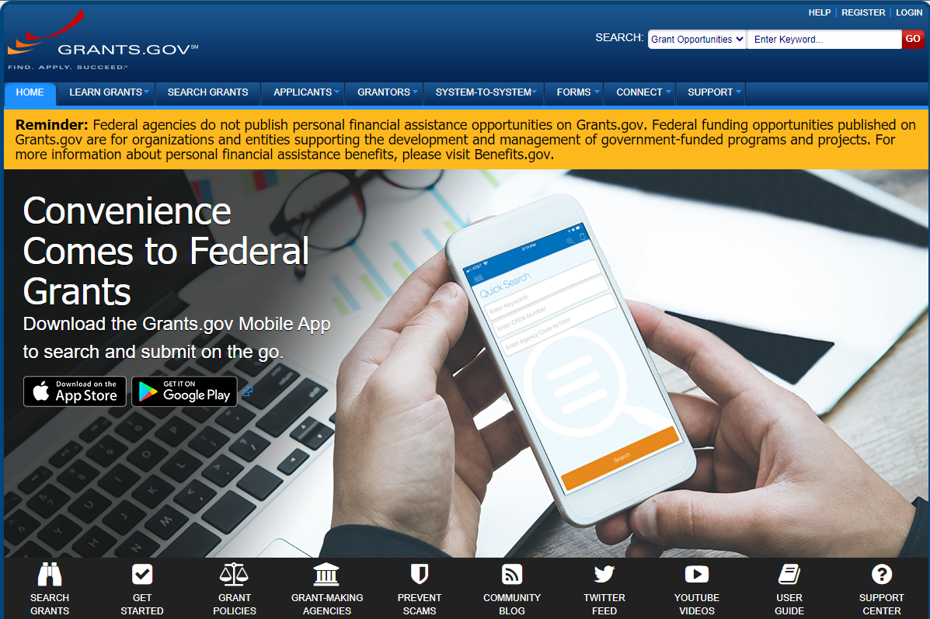
Application Tips Where to start?
Start at www.grants.gov

Slide 20
Application Tips What do I have to include in my application?
D.2.2. Application Content: The application must include the following elements to be considered complete:
Mandatory Federal Forms
SF-424 Application for Federal Assistance
SF-424 Budget Information (A or C Form, as applicable to the project)
SF-424 Assurances (B or D Form, as applicable to the project)
SF-LLL Disclosure of Lobbying Activities (if applicable)
These forms may be obtained at www.grants.gov/web/grants/forms/sf-424-family.html
Title page
Table of contents
Technical proposal and evaluation criteria (limited to X pages)
Executive summary
Project location
Project description
Evaluation criteria
Project budget
Funding plan and letters of commitment
Budget proposal
Budget narrative
Environmental and cultural resources compliance
Required permits or approvals
Letters of funding commitment
Letters of project support
Official resolution*
It is highly recommended that application packages be structured in the order identified above.
Every WaterSMART NOFO includes a section describing the application content
Page iii of every NOFO includes Application Checklist
All of the bulleted items must be included with your application by the application deadline, except those identified with a * may be submitted by the alternate deadline indicated in the NOFO
Application Tip: Structure your proposal in the order identified in the NOFO

Slide 21
Application Tips Evaluation Criteria
D.2.2. Application Content: The application must include the following elements to be considered complete:
Mandatory Federal Forms
SF-424 Application for Federal Assistance
SF-424 Budget Information (A or C Form, as applicable to the project)
SF-424 Assurances (B or D Form, as applicable to the project)
SF-LLL Disclosure of Lobbying Activities (if applicable)
These forms may be obtained at www.grants.gov/web/grants/forms/sf-424-family.html
Title page
Table of contents
Technical proposal and evaluation criteria (limited to X pages)
Executive summary
Background data
Project location
Technical project description
Evaluation criteria
Project budget
Funding plan Budget proposal
Budget narrative
Environmental and cultural resources compliance
Required permits or approvals
Letters of funding commitment
Letters of project support
Official resolution*
Unique Early Identifier and System for Award Management*
It is highly recommended that application packages be structured in the order identified above.
Make sure you respond to every criterion and every sub-criterion
Your responses should:
Directly respond to the criterion – copy and paste the criteria directly into your proposal and place your response immediately below each criterion/sub-criterion
Provide support in the form of quantification or links to reference documents
Make the case for how your project meets the criterion – general statements without explanation or support will not score well
Don’t assume that the reviewers know about the issues in your area, or the benefits of your project
Application Tip: Well-supported responses to the evaluation criteria are the key to writing a competitive proposal
Evaluation Criteria

Slide 22
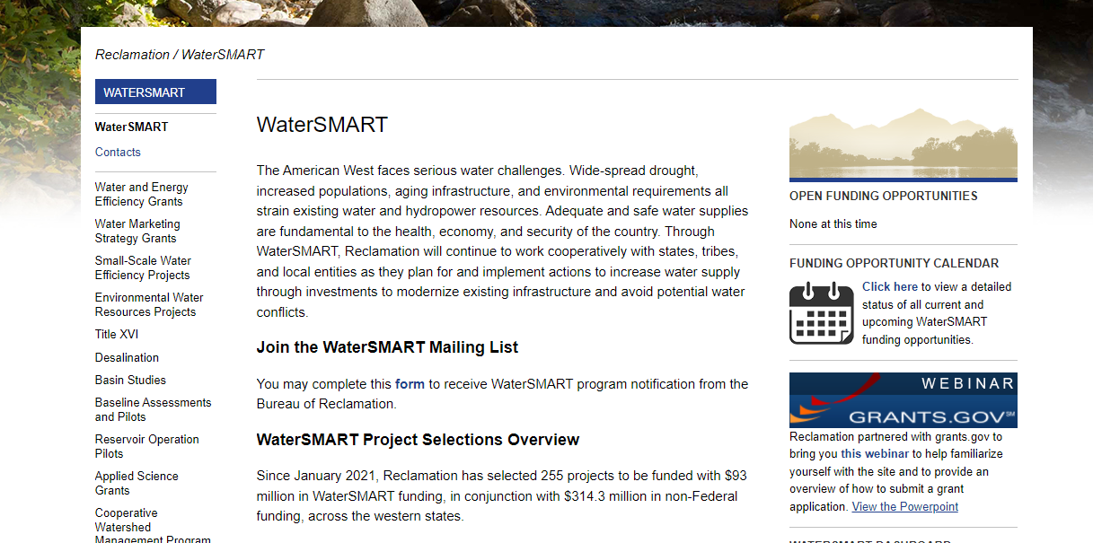
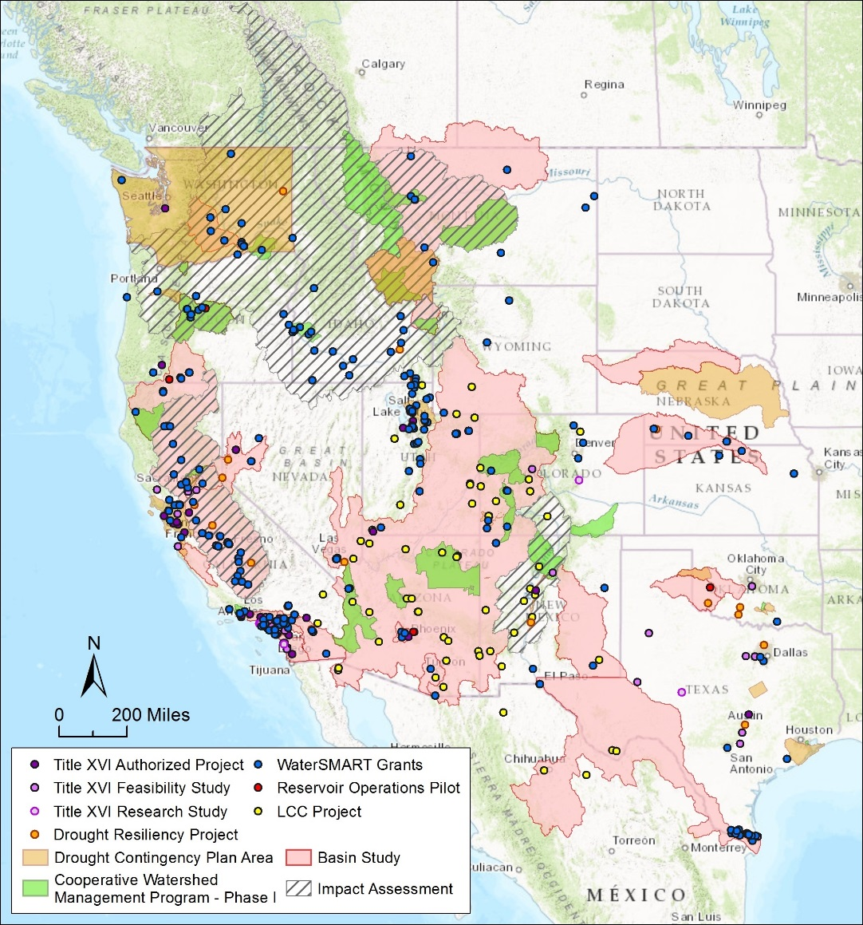
WaterSMART Program Resources
WaterSMART Program Website: https://www.usbr.gov/watersmart
Note: Successful proposals are available on the website for each program
For information about upcoming WaterSMART Funding Opportunities, sign up on WaterSMART Program Website
Funding Opportunities can be found at: www.grants.gov​
Data Visualization Tool: arcg.is/1TcT68S
Notes:
Data visualization site is an interactive tool including:
Interactive maps
Featured project tours
Program growth over time

Slide 23
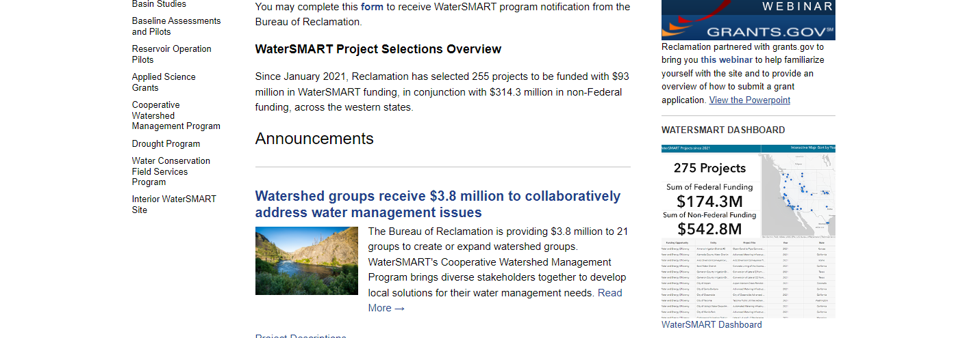
WaterSMART Tools
WaterSMART Program Dashboard
Data Portal that includes:
Historical funding information
BIL funding information
Recently selected WaterSMART Projects
Schedules for funding opportunities
Useful links to other interactive web pages such as Reclamation’s drought portal, current reservoir storage, projected changes to hydrology over time and our Collaborative Conservation Adaptation Strategy Tool Box

Slide 24
Questions?
CPN Regional Contact
Leah Meeks
lmeeks@usbr.gov
208-830-8562
Water and Resources Planning Office
Sheri Looper Katherine Tucker
slooper@usbr.gov ktucker@usbr.gov
916-978-5556 303-445-2586

