Slide 1
Reclamation Update
2022 Washington State Water Resources Association
December 1, 2022
Jennifer Carrington, Regional Director

Slide 2
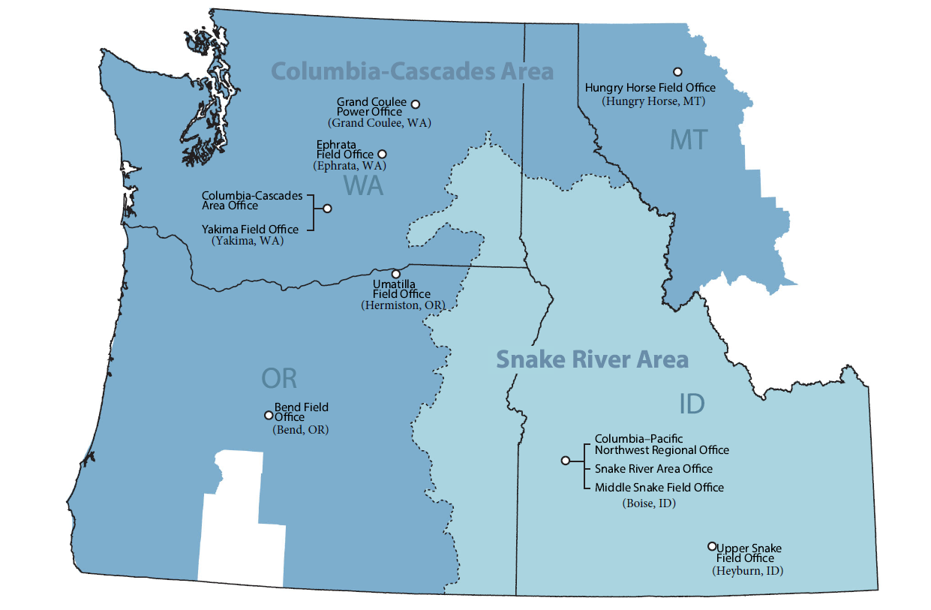
Columbia-Pacific Northwest Region

Slide 3
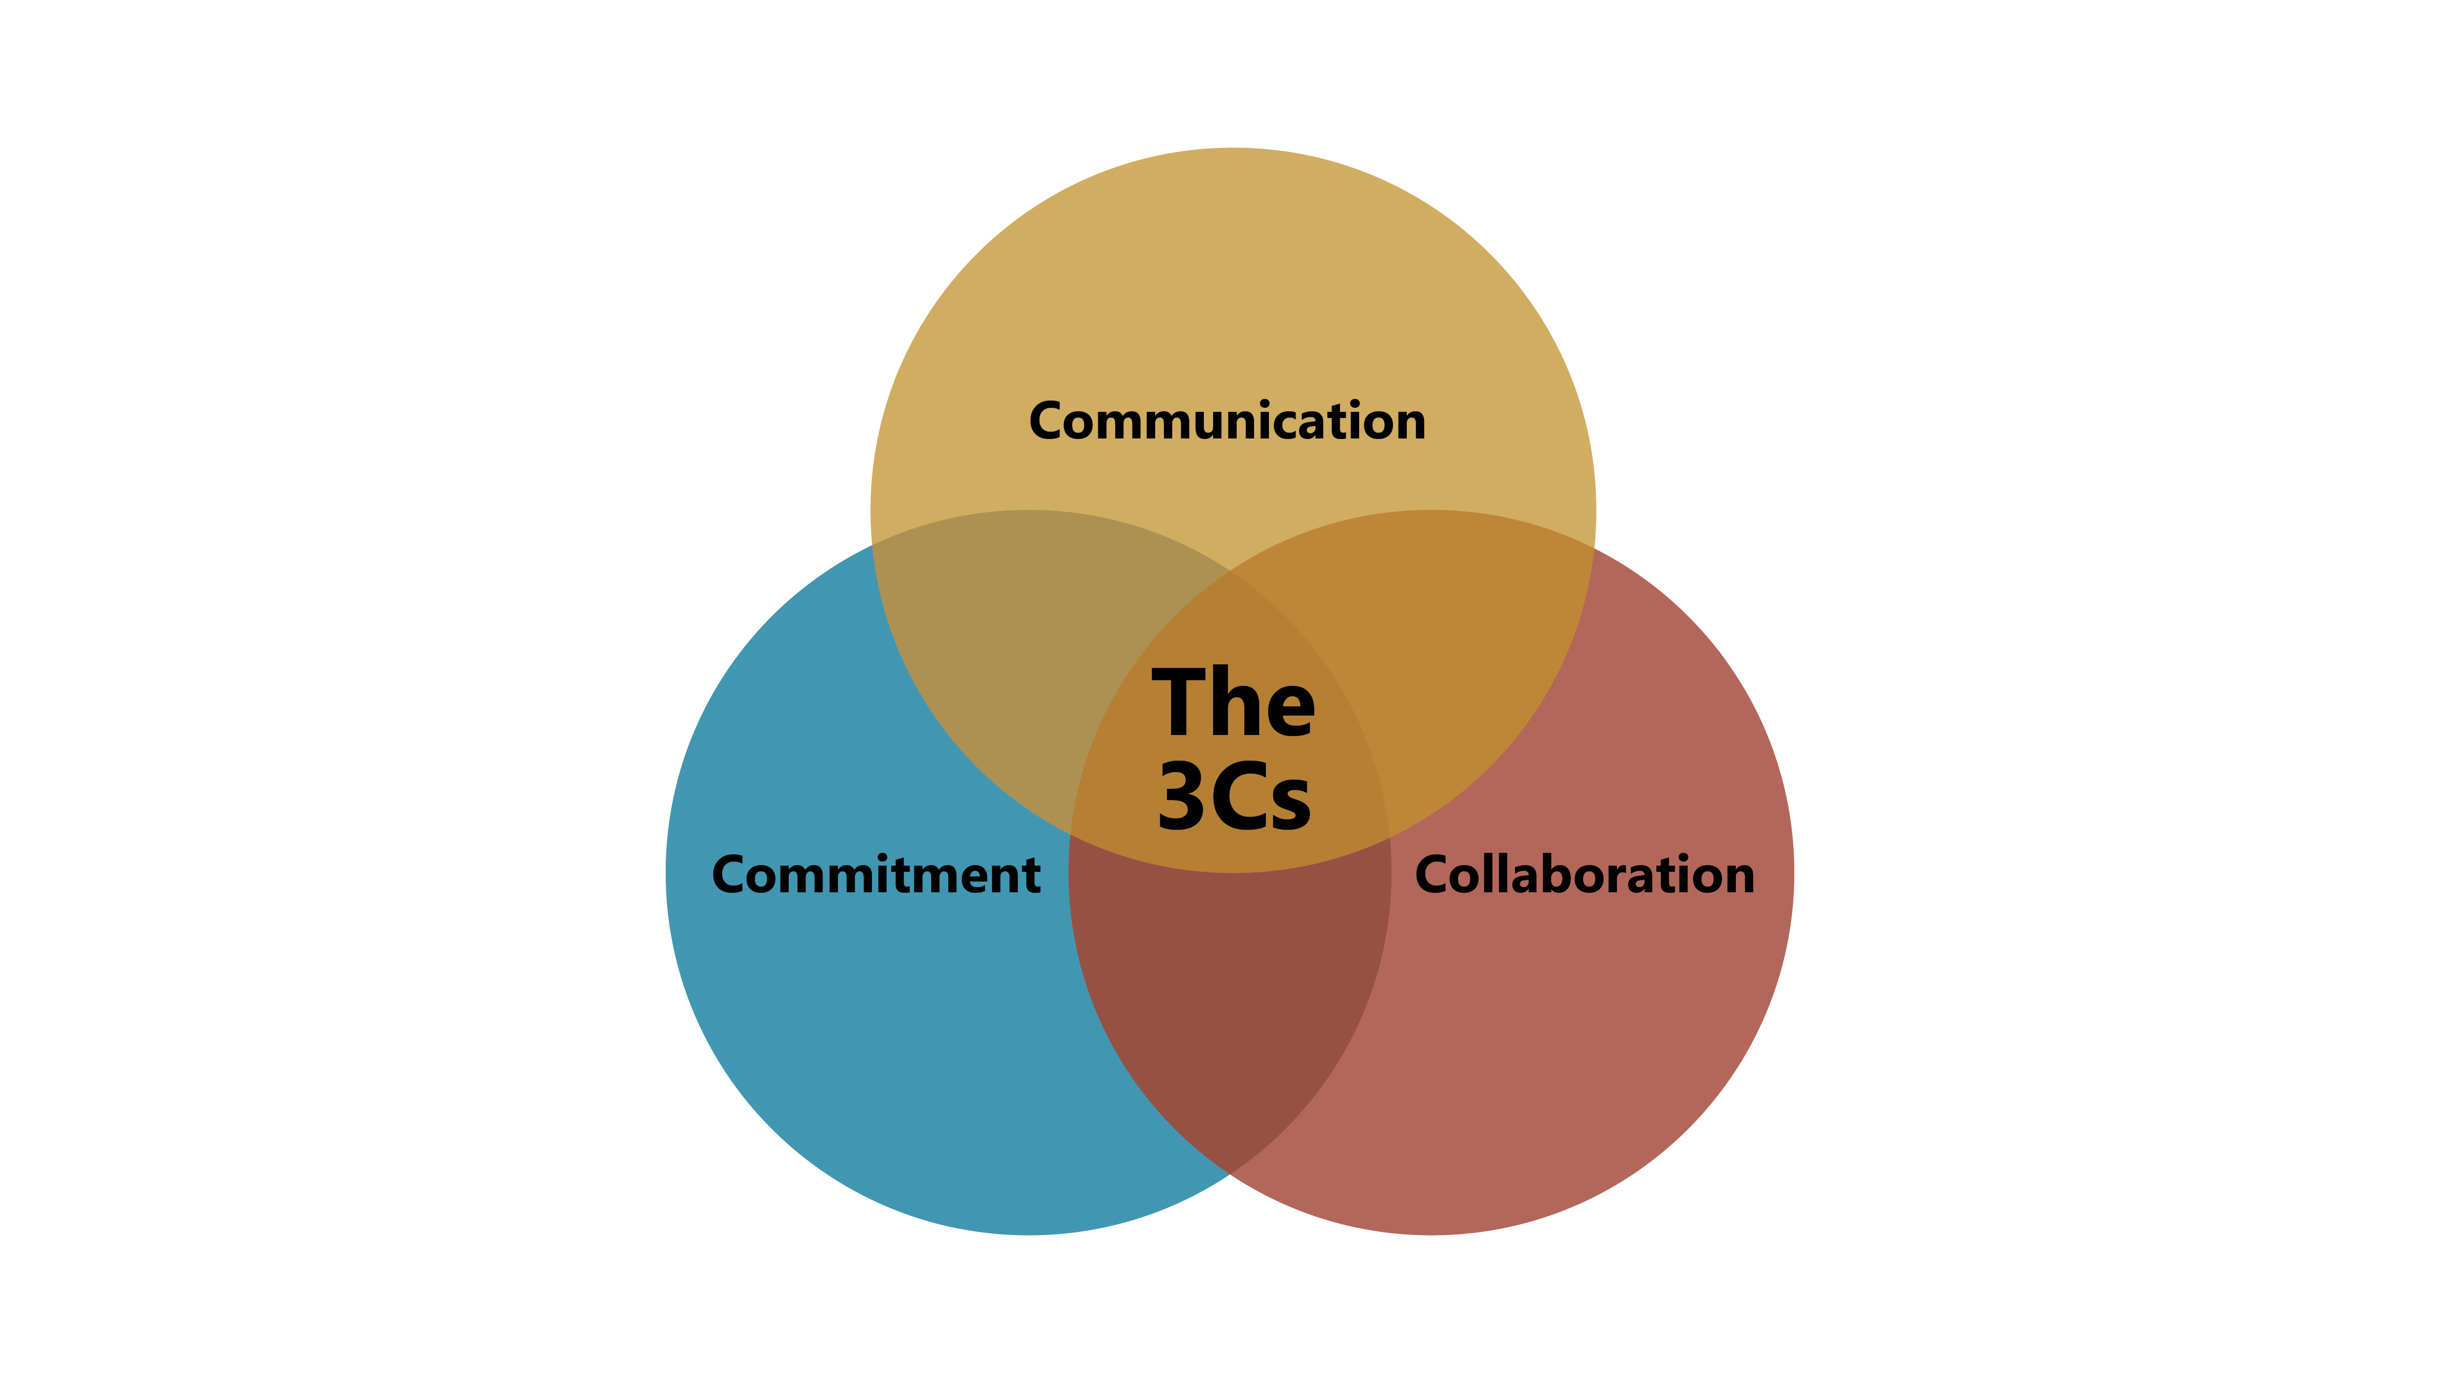
Columbia-Pacific Northwest Regional Leadership Philosophy

Slide 4
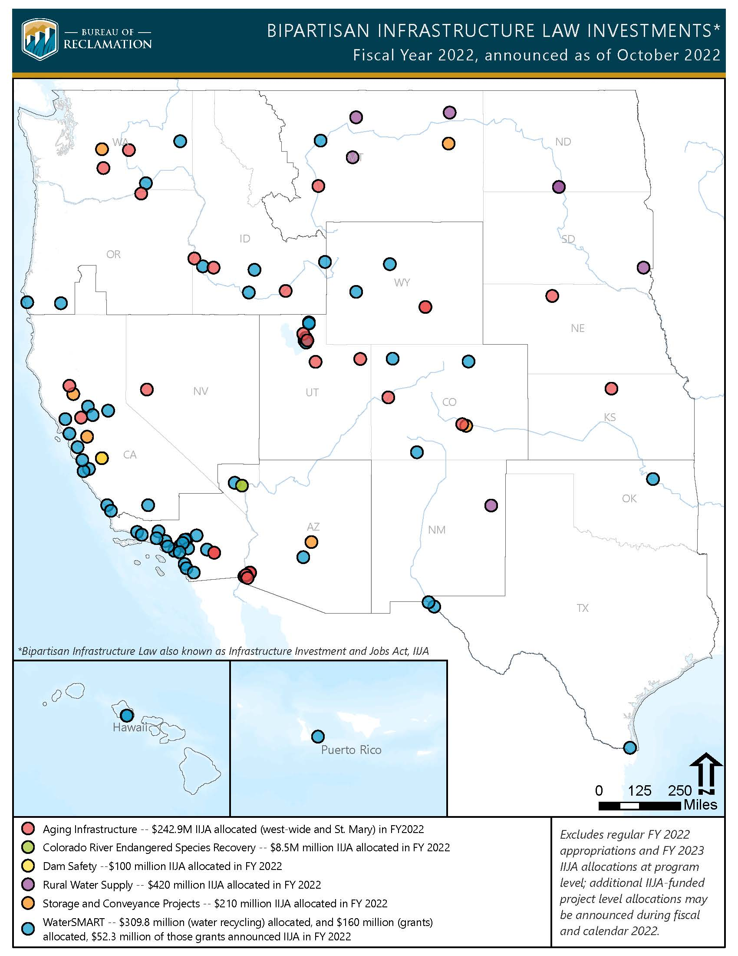
Bipartisan Infrastructure Law
Bipartisan Infrastructure Law - $8.3B over Five Years
Reclamation-$604.6M allocated; $158.3M to stakeholders
CPN Region-17 Projects; $38.1M
Washington – 5 Projects; $14.2M
Keys Pumping Plant Authorization
Aging Infrastructure Account
FY 2023 - $649M
Applications Due – December 22

Slide 5
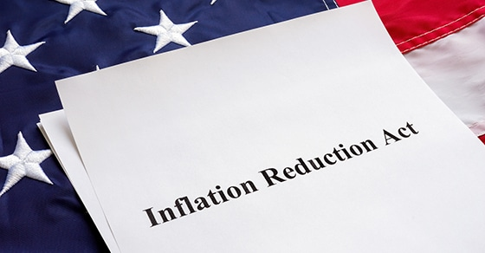
Inflation Reduction Act
Key Department of Interior Provisions:
$4 billion to address the worsening drought crisis in the West
$650 million to increase staff and personnel across DOI bureaus
$500 million for land resilience, conservation, and habitat restoration
$411 million for investments in Tribal and Native Hawaiian communities

Slide 6
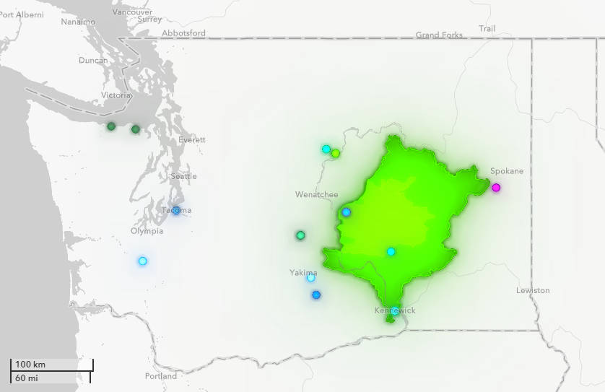
WaterSMART
Reclamation-Since January 2021; $188.4M Funded; 327 Projects
Washington – 17 Projects: $9.3M, 2 Plans $200k
Kennewick Irrigation District
Quincy-Columbia Irrigation District
Selah Moxee Irrigation District
Columbia Irrigation District
East Columbia Basin Irrigation District
Kittitas Reclamation District
Lake Chelan Reclamation District
Cities of Cheney and Tacoma
Chelan County Nat. Res. Dept.
Confederated Tribes of the Yakama Nation
Grant County Conservation District
Lincoln County Conservation District
TransAlta Centralia Generation, LLC

Slide 7
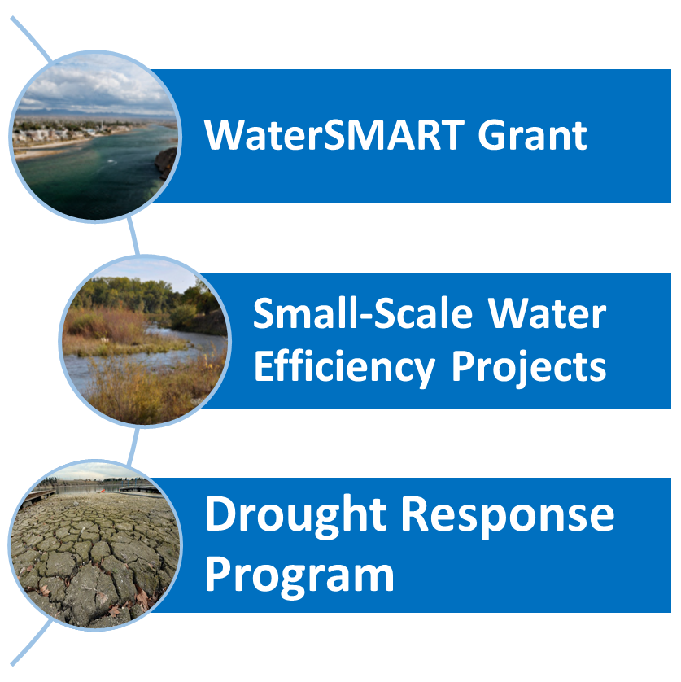
WaterSMART Funding Opportunities
Environmental Water Resources Program
Water Conservation Field Services Program
Water Marketing Strategy Grants
Applied Science Grants
Aquatic Ecosystems Restoration Projects
Small-Scale Water Efficiency Projects
Water and Energy Efficiency Grants
Drought Resiliency Projects

Slide 8
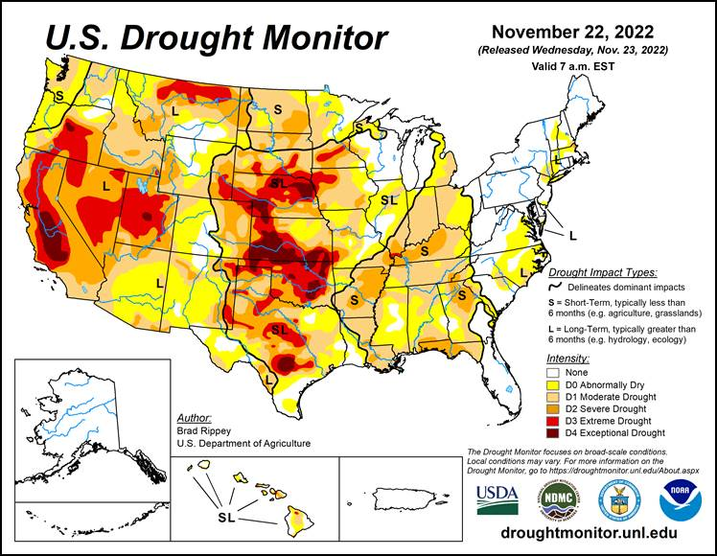
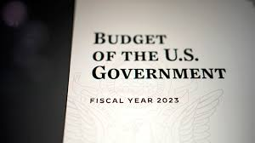
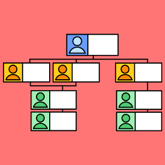
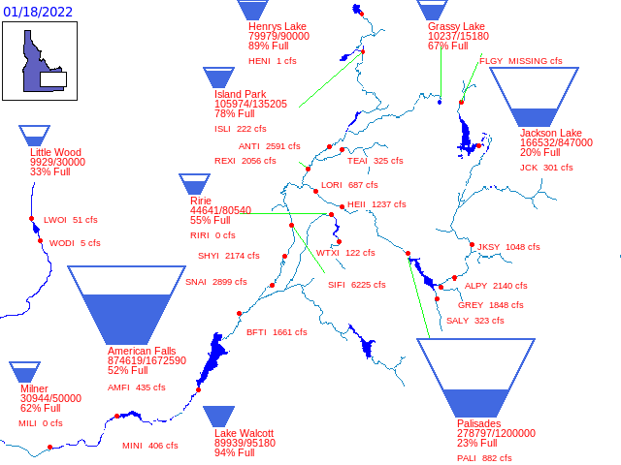
Highlights
FY 2023 Budget
Basin Conditions
Organizational Updates

Slide 9
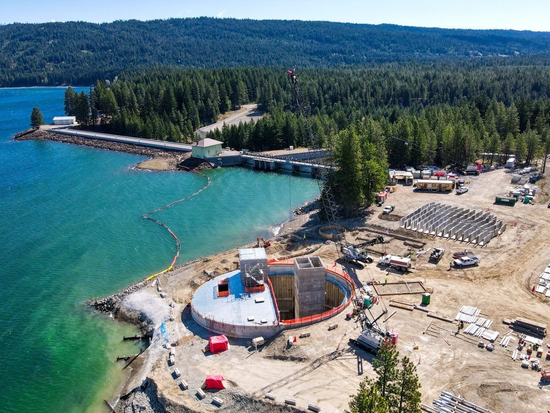
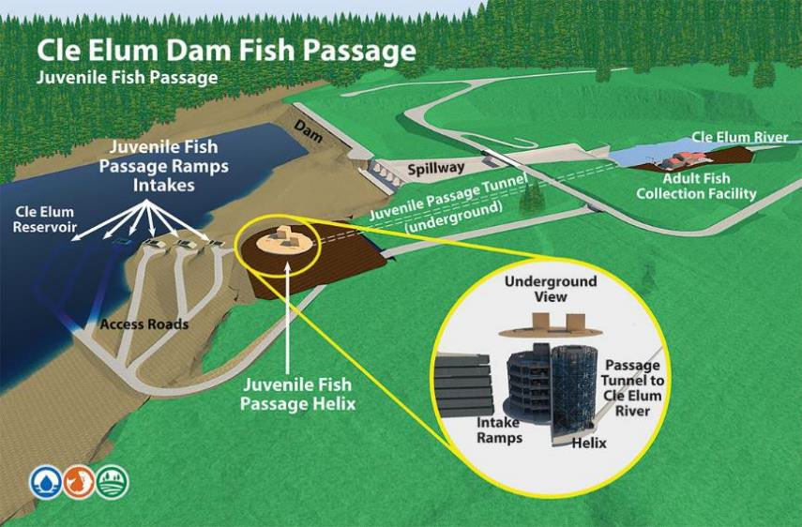
Project Updates
Potholes/Dieringer Dairy
Yakima Integrated Plan
Cle Elum Fish Passage
Cle Elum Pool Raise
Yakima O&M Consultation

Slide 10
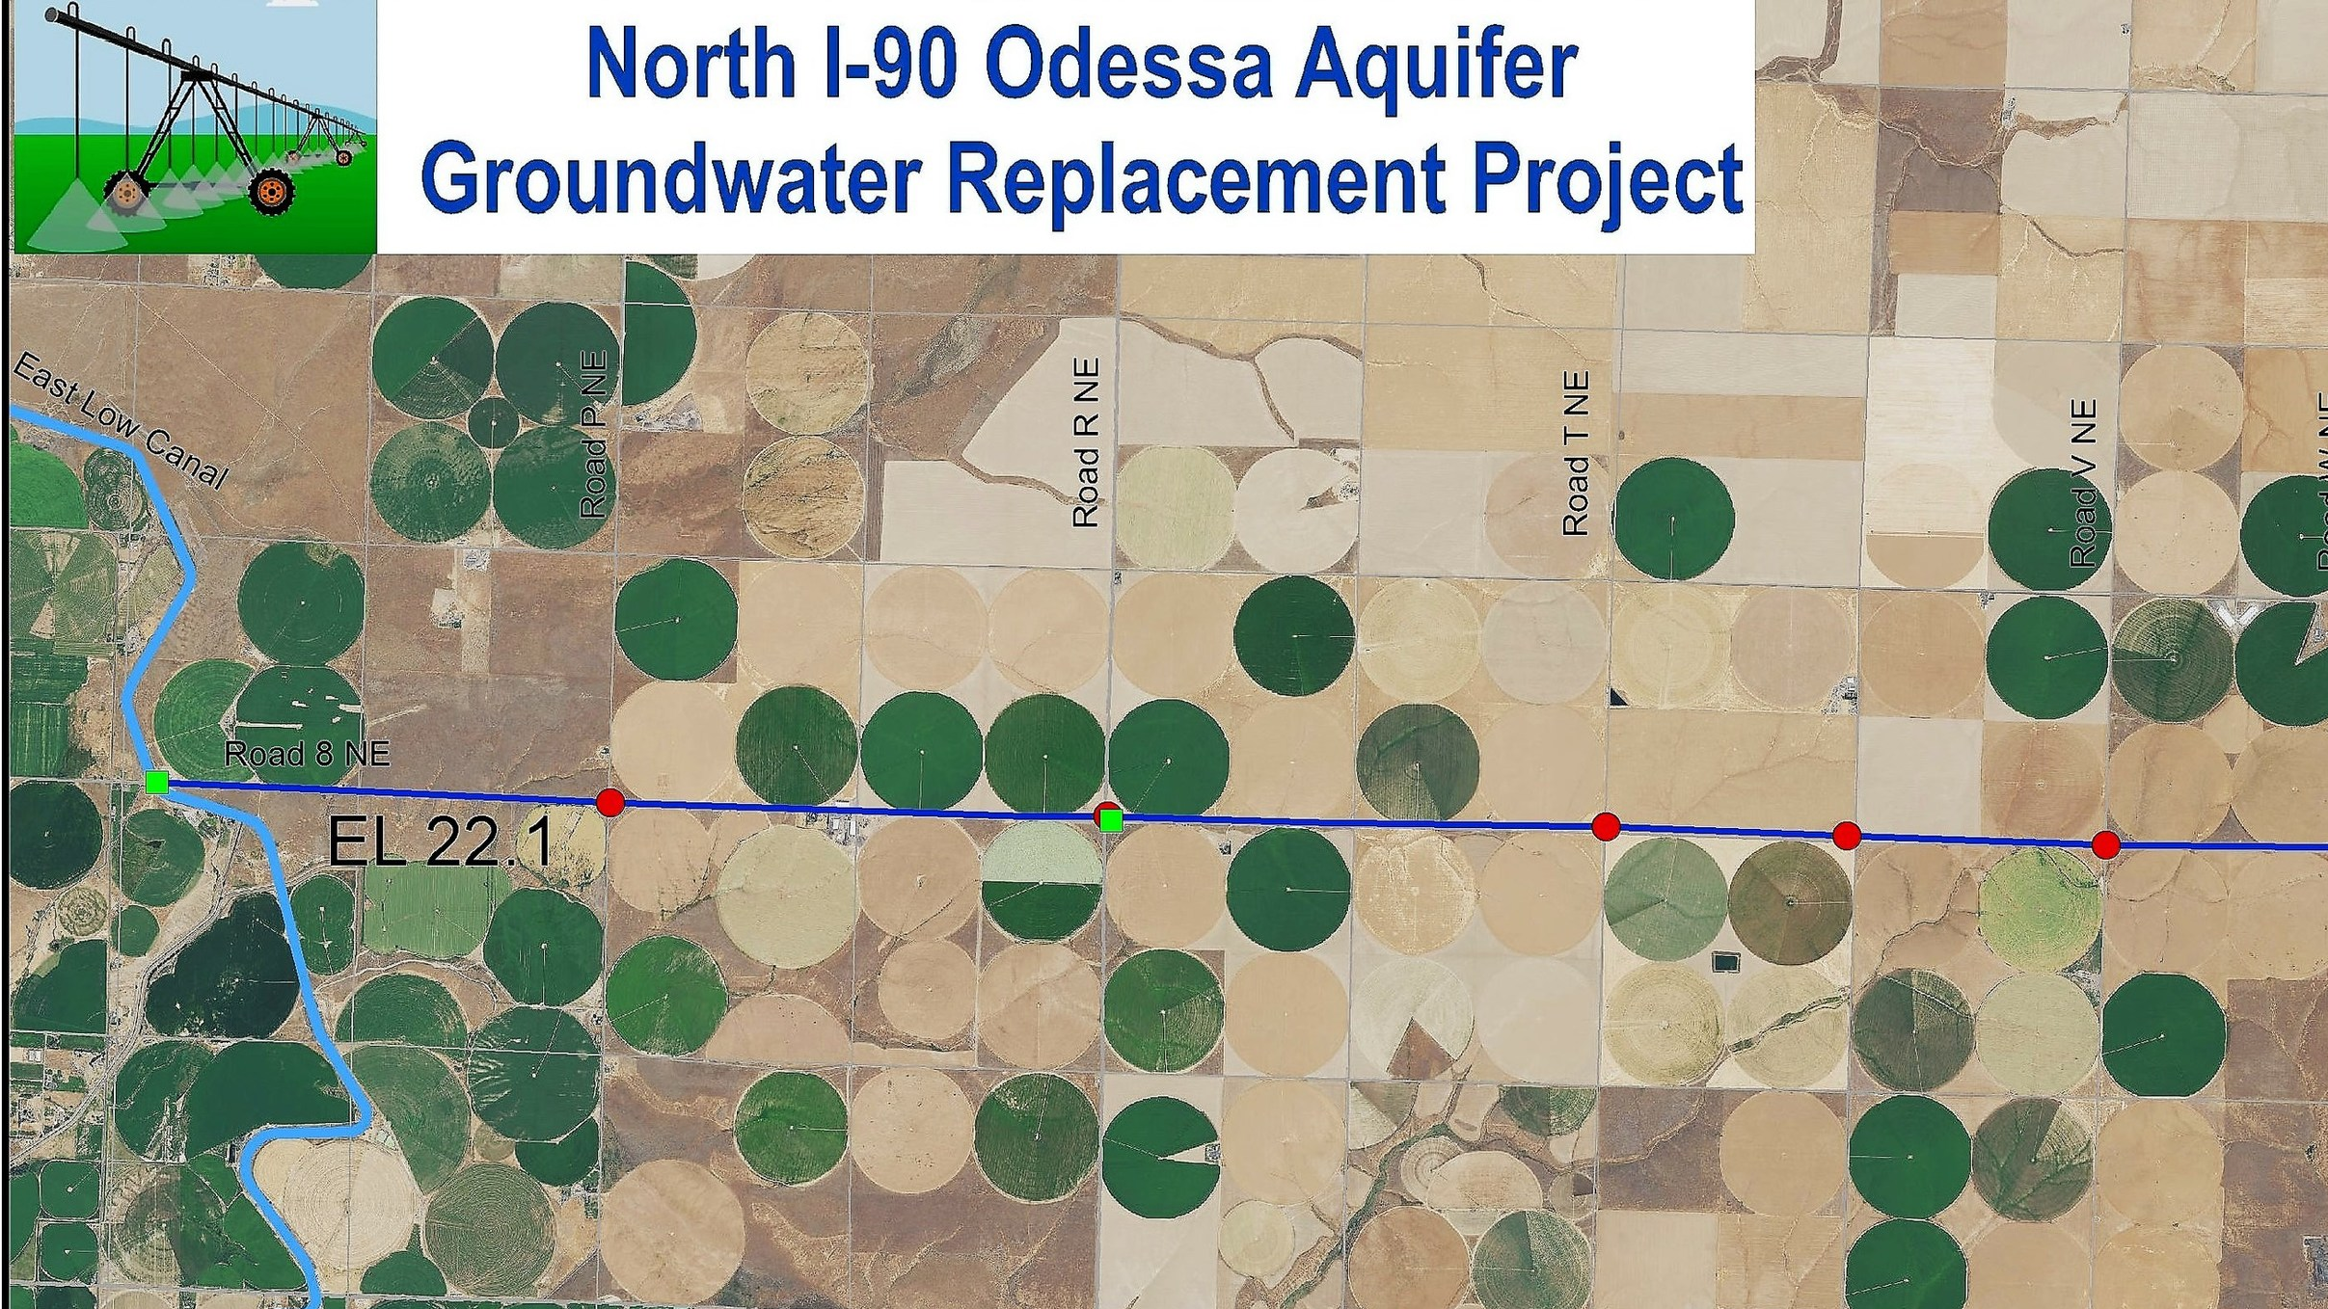
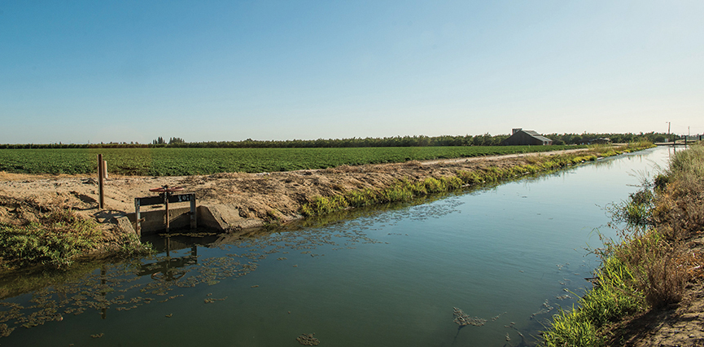
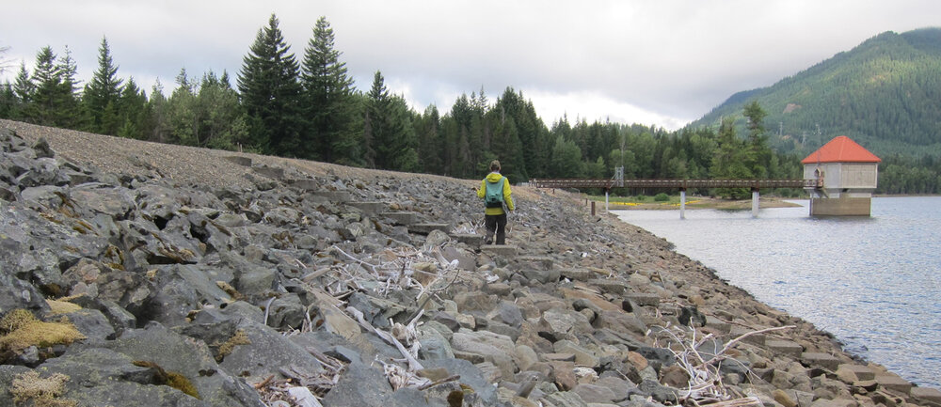
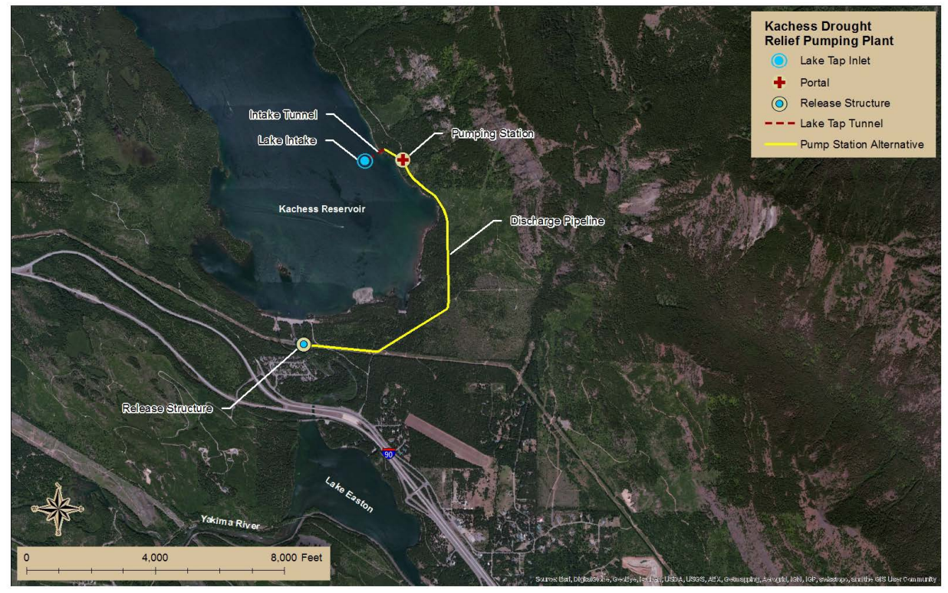
Project Updates
Odessa Groundwater Replacement
Kachess Safety of Dams
Kachess Drought Relief Pumping Plant

Slide 11
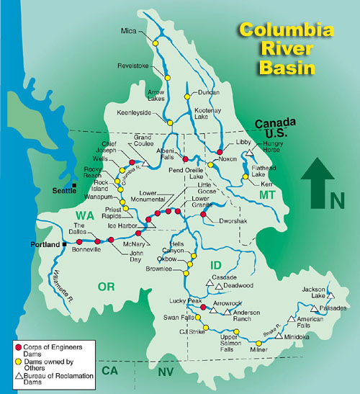
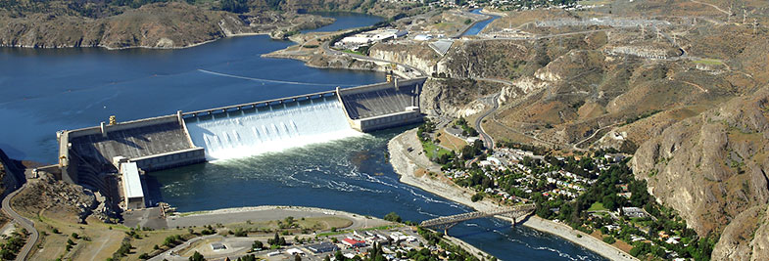
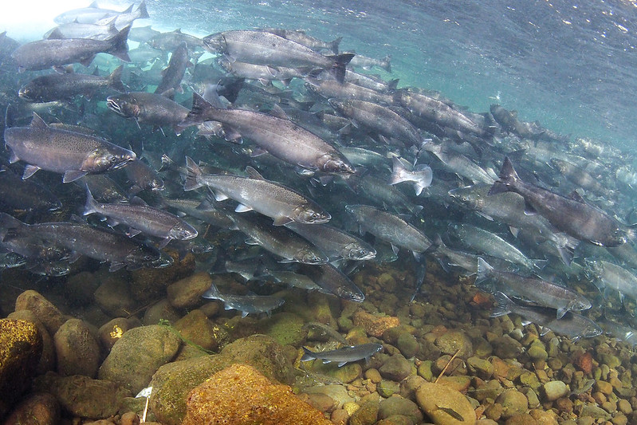
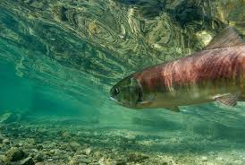
Regionwide Issues
Columbia River Systems Operations Litigation
Columbia River Treaty

Slide 12
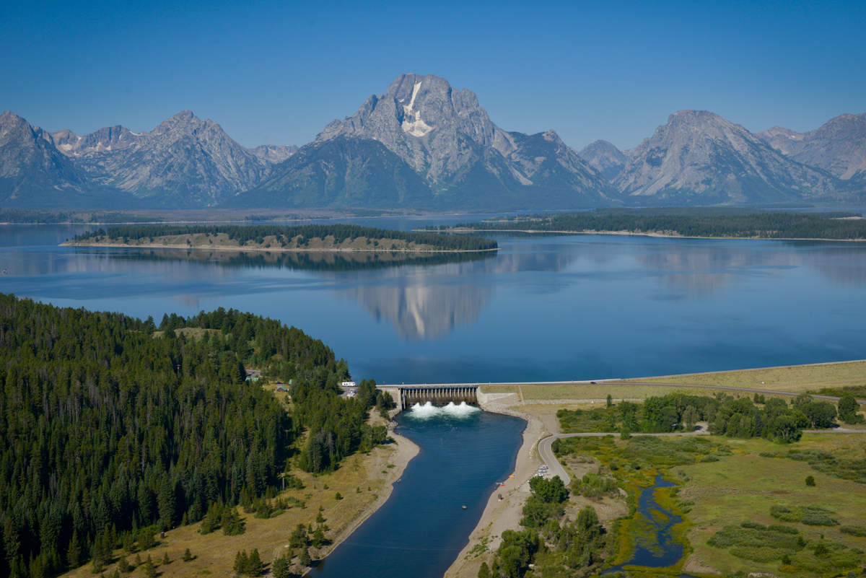
Thank you!

